Slide 1
Parish Property Team 2026
“To support, serve and resource all parts of the Diocese of London in enabling every Londoner to encounter the love of God in Christ.”
Notes:
SW

Slide 2
Introduction
Sarah Wall
Parish Property & Fundraising Team Coordinator
Notes:
SW

Slide 3
Parish Property
“Do the right thing”
“Good fences make good neighbours”
“Cheap rents make bad tenancies”
“start early and act strategically”
…procedurally, financially, ethically
…and good leases make good tenancies
…Governance for very closely aligned charitable support
“To support, serve and resource all parts of the Diocese of London in enabling every Londoner to encounter the love of God in Christ.”
Reducing costs
Generating better incomes
Help make buildings more appropriate
We welcome visits to your parish – the best way to help you identify opportunities and discuss challenges.
Notes:
HT

Slide 4
Kevin Rogers
Director of Parish Property & Fundraising
Patrick Booth
Buildings Advisor DAC
Isabelle Ryan
Senior Casework and Building Strategy Adviser
Harry Torrance
Head of Asset Management
Nicole Crocket
Head of Development
Elizabeth Hung
Church Buildings Advisor – Buildings for Mission
David Gregory
Asset Manager
Sarah Wall
Team Coordinator
Virginia Featherstone
Legal and Pastoral Manager
Alexandra Williams
Senior Project Manager
Tony Youd
Asset Manager
Jimmy Bell
Asset Manager
Aby George
Administration Assistant
George Bell
Senior Development & Fundraising Manager
Sarah Hamilton
Senior Asset Manager
David Gregory
Development Manager
Mark Featherston Deeds and Records Clerk
Parish Property & Fundraising Team

Slide 5
PCC Powers Measure 1956 the right thing procedurally
Since 1956, PCCs no longer have the power to own property outright.
The LDF owns property as Diocesan Authority (formerly Custodian Trustee) for the PCC.
PCCs are Managing Trustees
As such PCCs hold the responsibility to manage and maintain the buildings (including Insurance and Health and Safety) and are the beneficiaries of any income.
This legal structure means that the LDF need to review and approve any transaction involving the leasing or disposal of any property.
The LDF will also need to be a signatory on the legal documents involving leasing or disposal outside of faculty jurisdiction.
Link to the PCC Powers Measure 1956:
https://www.legislation.gov.uk/ukcm/Eliz2/4-5/3/contents
Notes:
HT

Slide 6
Parish property - Leases and licences the right thing procedurally
As a parish, you will be responsible for certain buildings:
The church, hall, other parish property (flats, houses etc.)
If it would better enable your mission, you may rent out these spaces to create income.
This income can be used by the parish to help fund other mission activities and/or the repair and maintenance of the properties within their care.
In terms of permissions needed from the Diocese:
This practice is commonplace and is welcomed!
Certain steps need to be followed to ensure fiduciary duties are met under the Charities Act or Ecclesiastical Law.
Please contact Sarah Wall at the earliest opportunity who will be happy to talk you through the required steps.
Disentangling has a time and legal cost.
Notes:
SW

Slide 7
Hiring out your Church Hall the right thing financially
Assuming your church hall is not under Faculty (some are, if they form part of the church building itself), then it is governed by the Charities Act 2022.
The Charities Act 2011 sets out various requirements for Charity Trustees (PCCs) when making disposals of land including “on the best terms available”
The meaning of “disposal” is wide. Most common to PCCs:
Leases for over 7 years
Leases for less than 7 years where a fine or premium is paid
Granting or releasing a right, easement, wayleave or restrictive covenant
Licences to occupy – other worshipping communities
The key principles are that Trustees must take professional advice prior to any agreement being made.
Sharesy: https://www.sharesy.com can be used for one off hires
Notes:
SW
HT So what? Hide behind the Charities Acts.

Slide 8
Further Professionals to be consulted the right thing ethically
Formal Legal Document
Agree heads of terms: PCC, LDF, Tenant ( / licensee)
Instruct a solicitor to draft documents
Lease or licence? Take advice from a solicitor
Governance in place for very closely aligned charitable support
Other Professional Advice / Certification
Energy Performance Assessment – EPC rating to be ‘E’ or above set to rise to ‘C’ for new commercial leases in April 2025 - there are exemptions
Valuation – third party objective advice well evidenced
Health and Safety requirements
Is the Tenant Represented?
Notes:
SW / HT

Slide 9
What documents are needed for LDF Approval? Good estate management
Designated Advisor Report and/or copy of any advice from professional advisor
PCC Resolution and Minutes
Plans/Drawings
Photographs
Anything else that might be useful
Please send to Sarah Wall
Notes:
SW

Slide 10
Other parish property
Often a parish will have a house or a flat that it rents out to individuals
Usually these agreements are Assured Shorthold Tenancies (AST’s) and if the parish does not use an agent a document can be downloaded:
https://assets.publishing.service.gov.uk/government/uploads/system/uploads/attachment_data/file/1084131/Model_agreement_for_a_shorthold_assured_tenancy.pdf
Many parishes use managing agents and they will keep you up to date with all the legal requirements needed (including fair pricing etc)
Whether or not using a managing agent the LDF need to be a signatory to the AST’s
Renters Bill
Scale
Notes:
SW / HT

Slide 11
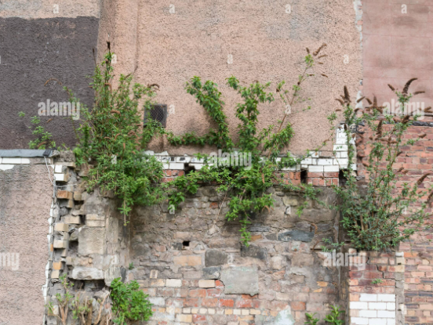
Caring for Property
Notes:
ht

Slide 12
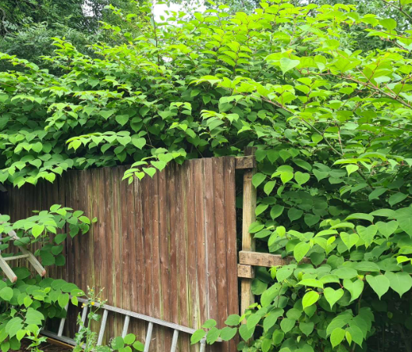
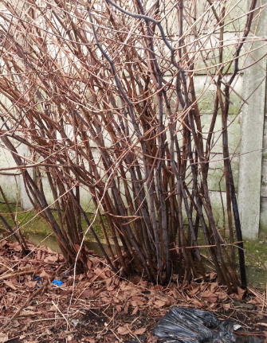
Caring for Property
Notes:
ht

Slide 13

Caring for Property
Notes:
ht

Slide 14
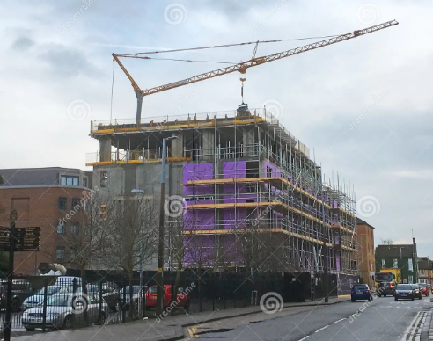
Opportunities for Property
Notes:
ht

Slide 15
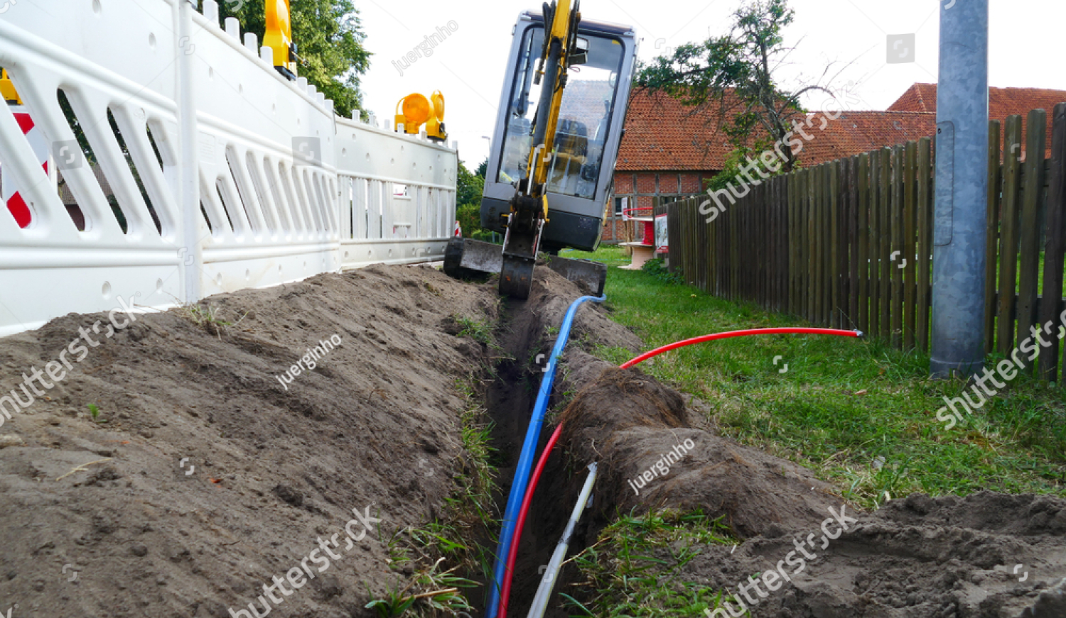
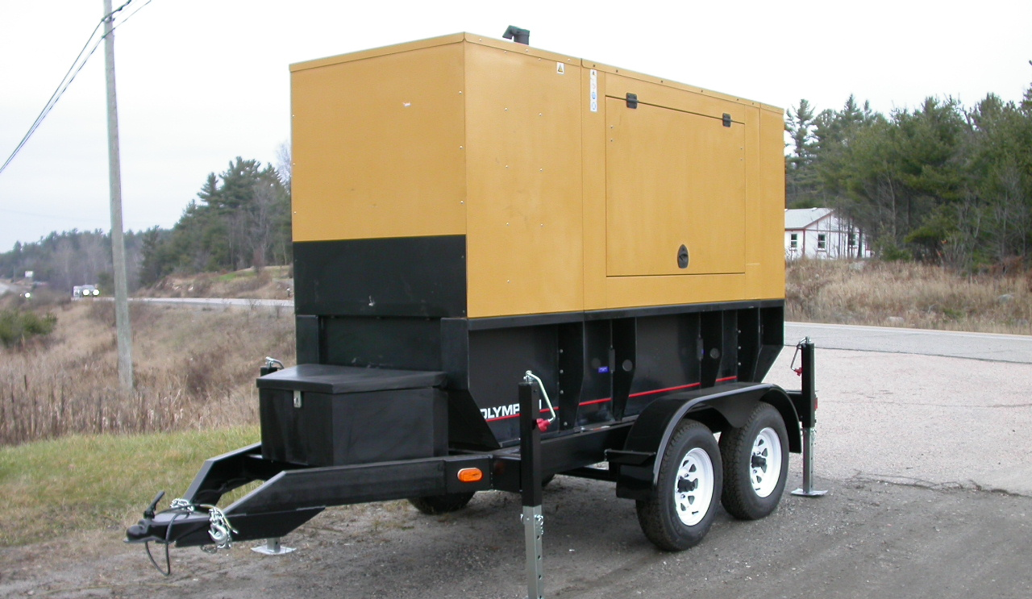

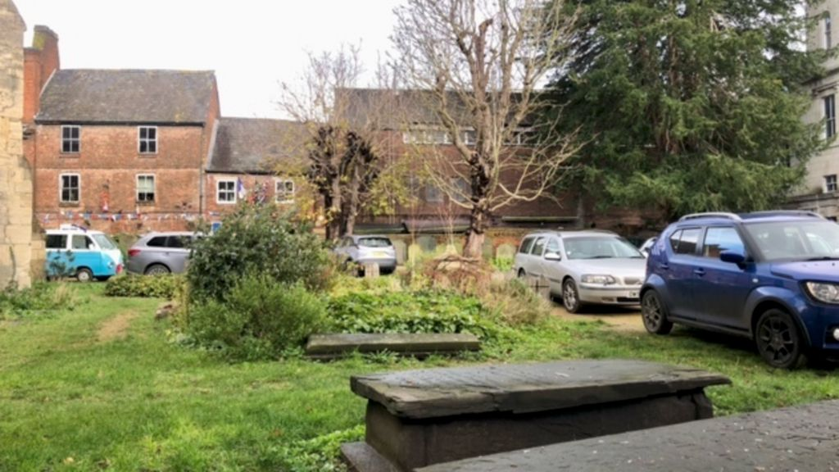
Opportunities for Property
Notes:
ht

Slide 16
Property Conclusion
“Do the right thing”
“Good fences make good neighbours”
“Cheap rents make bad tenancies”
“start early and act strategically”
Walk the bounds!
“To support, serve and resource all parts of the Diocese of London in enabling every Londoner to encounter the love of God in Christ.”
Notes:
HT

Slide 17
Who to contact:
All our details are on the LDF website:
https://www.london.anglican.org/church-and-parish-support/buildings-and-property/
Notes:
SW

