Slide 1

Notes:
I am here to introduce the Church of England’s Cornerstone platform.
Parish ministry and mission depend on generosity in money, time and talents.
Many parishes are carrying significant pressures: rising costs, limited volunteer capacity, and uncertainty about funding.
Cornerstone has been developed to give churches practical tools, clearer information, and resources that can help them respond well

Slide 2


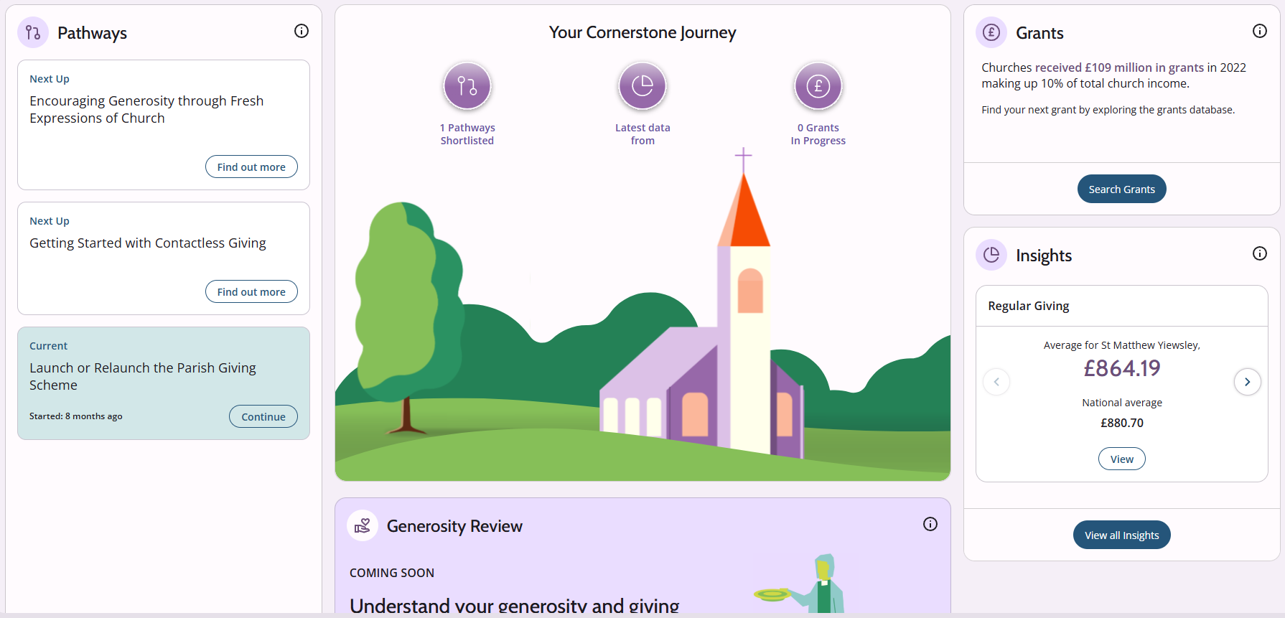
Notes:
Cornerstone is a free online tool developed by the National Giving Team to help churches strengthen giving and build a more generous culture. It has three main components:
Insights: which gives better visibility of parish giving and finance data
Pathways: which offers structured resources and practical actions
and Grants: which provides access to a substantial grants database
For treasurers, this means better visibility, better information, and better tools.
For churchwardens, it means clearer conversations, practical resources, and help in linking mission, buildings and funding.

Slide 3
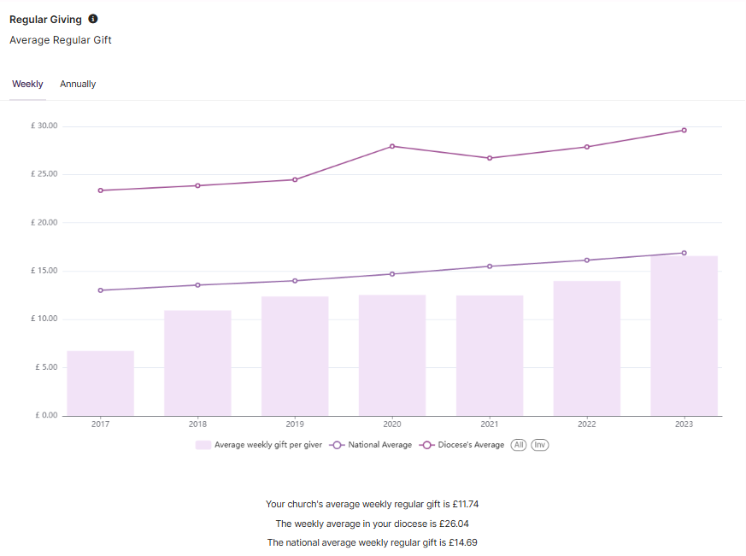
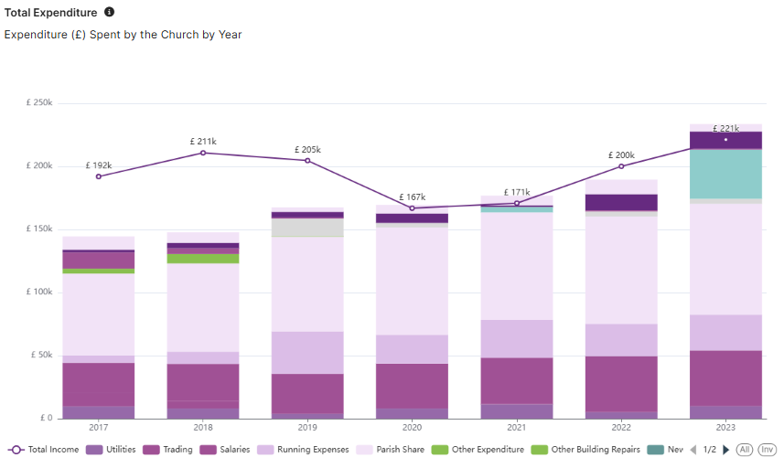
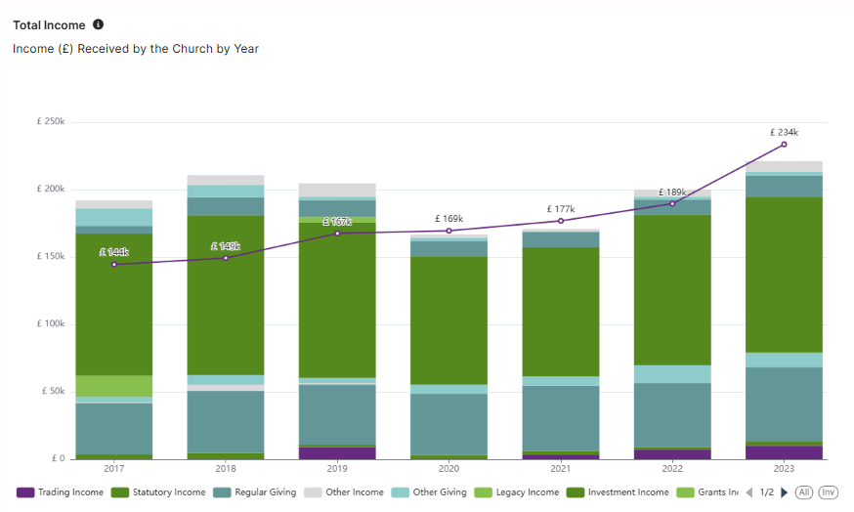
Notes:
So now we are going to scroll through the 3 components; Insights, Pathways and Grants…..
Let’s begin with Insights.
This part of Cornerstone uses Parish Returns data to give churches a clear picture of their financial position.
It shows patterns in regular giving, worshipping community, grants and legacies, income, expenditure and reserves,
helping parishes see strengths, pressures and risks more clearly.
At present, the most recent data shown is from 2023, the platform is under continuous development, and the latest figures will be updated

Slide 4
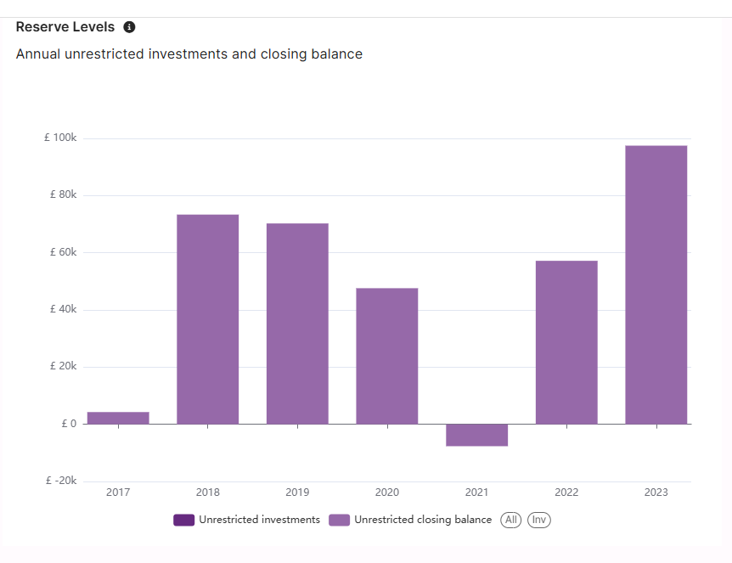
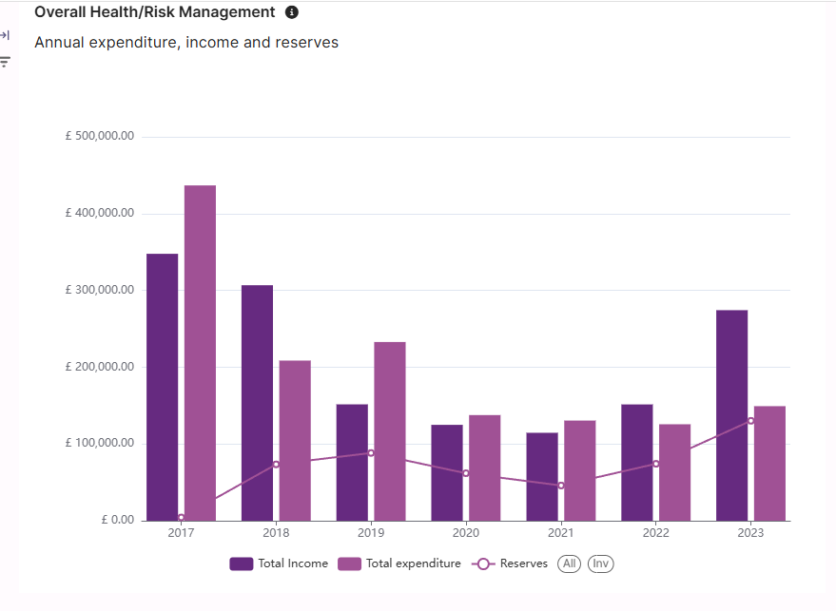
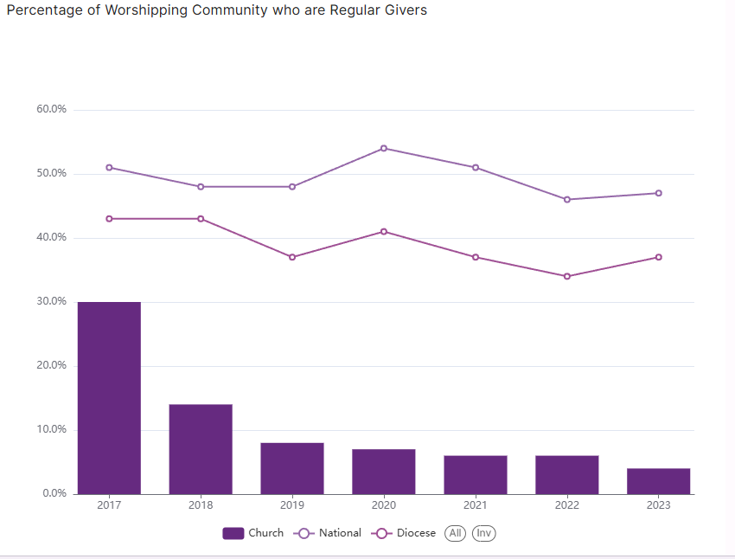
Notes:
It shows patterns in regular giving, worshipping community, grants and legacies, income, expenditure and reserves,
helping parishes see strengths, pressures and risks more clearly.
For example, in this parish the proportion of regular givers within the church community is below both the diocesan and national average. There may be many local reasons for that, but the value of the data is that it helps highlight areas which may merit further attention.
You will see that the most recent data shown is from 2023, the platform is under continuous development, and the figures are expected to be updated very soon.

Slide 5
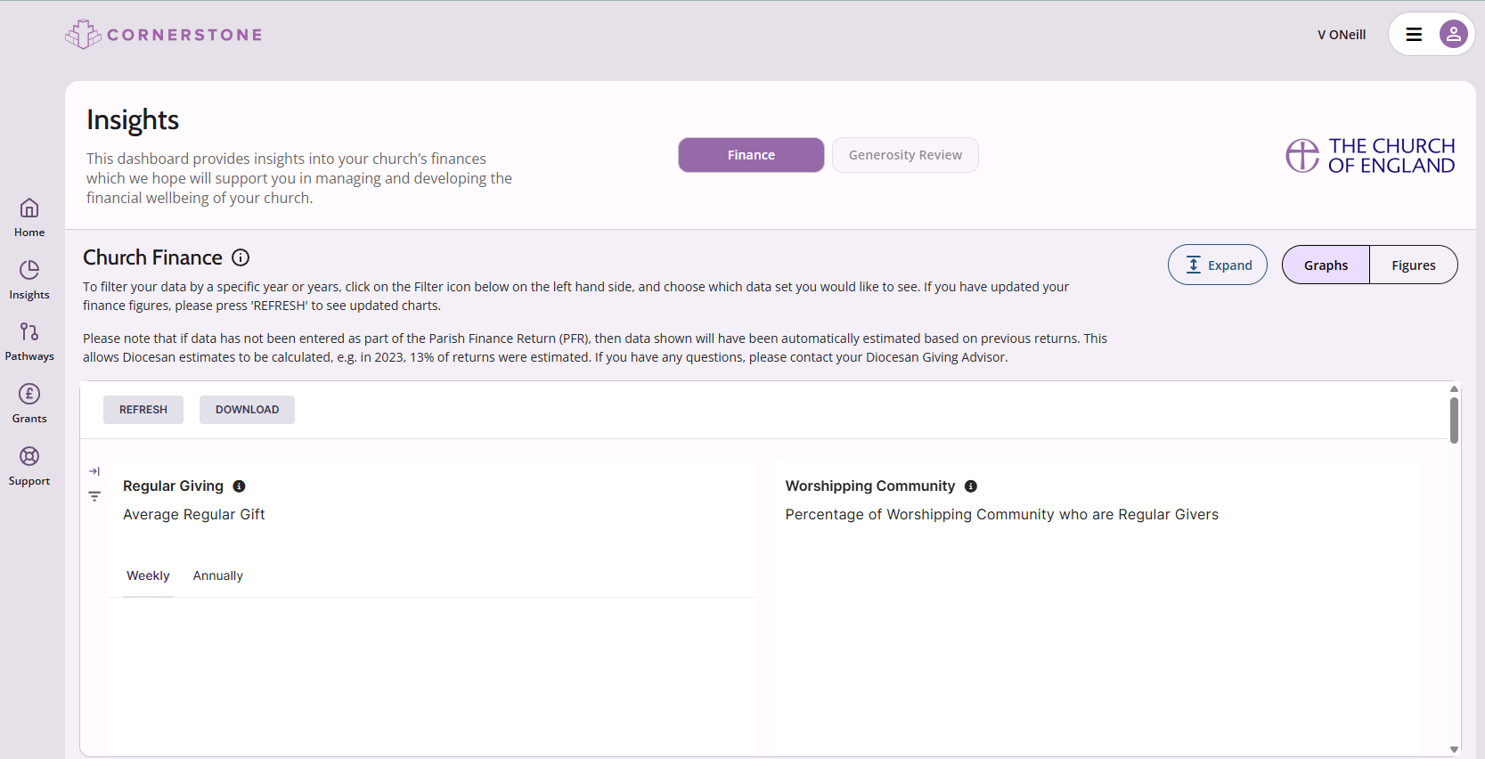

Notes:
As I just mentioned the system is still in development
It has been launched in Beta mode, which is a bit like a soft launch,
and one of the sections which is not yet live is the Generosity Review which is embedded in the Insight section,
and will provide you with a report like this: [CLICK FOR next slide]

Slide 6
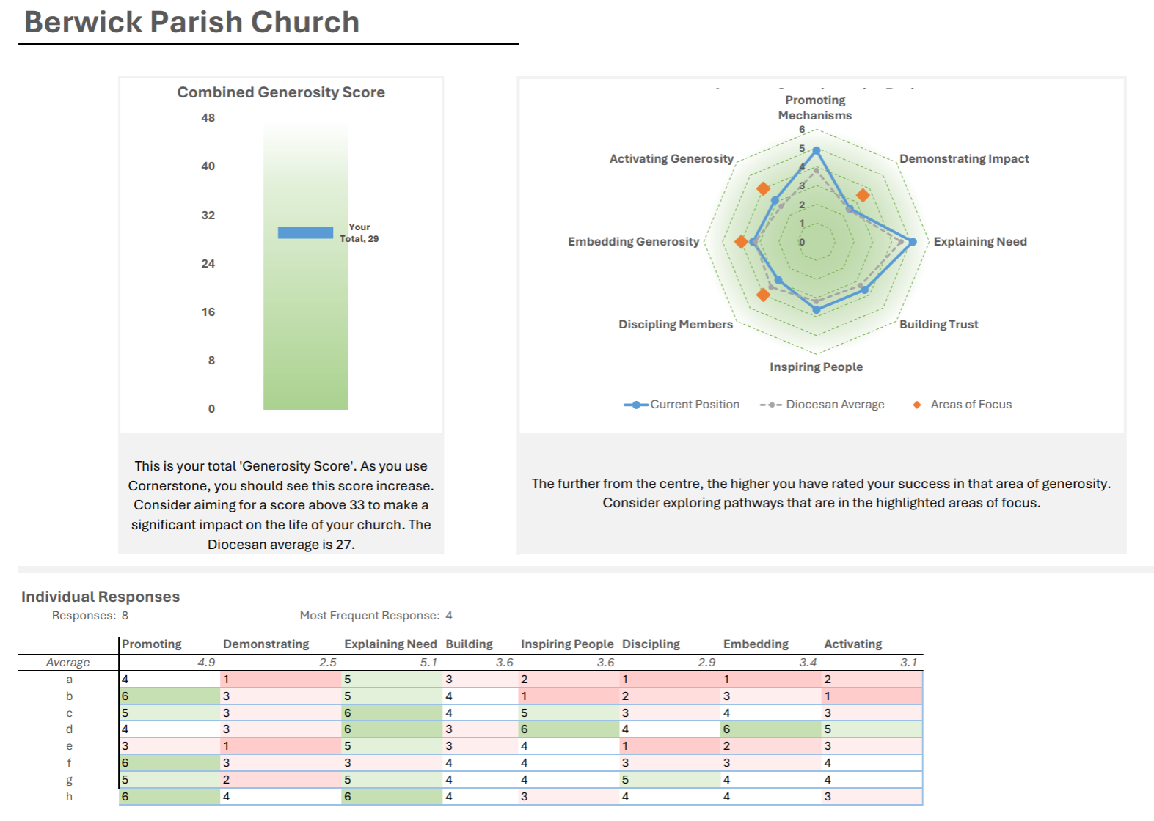
Notes:
The spider diagram is especially helpful, as it can show which areas within the MINT and IDEA frameworks may be strongest, and which may need more attention.

Slide 7

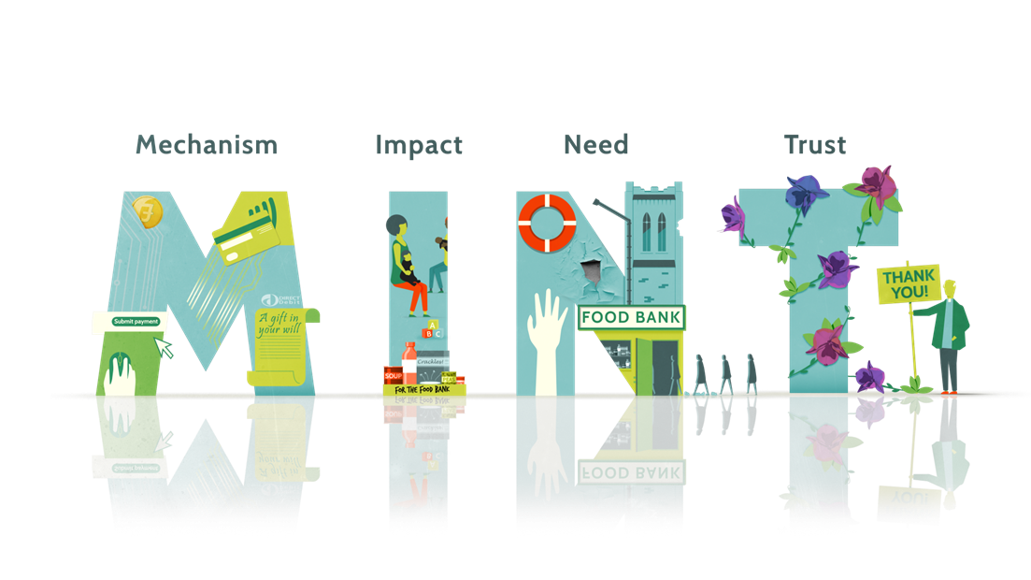
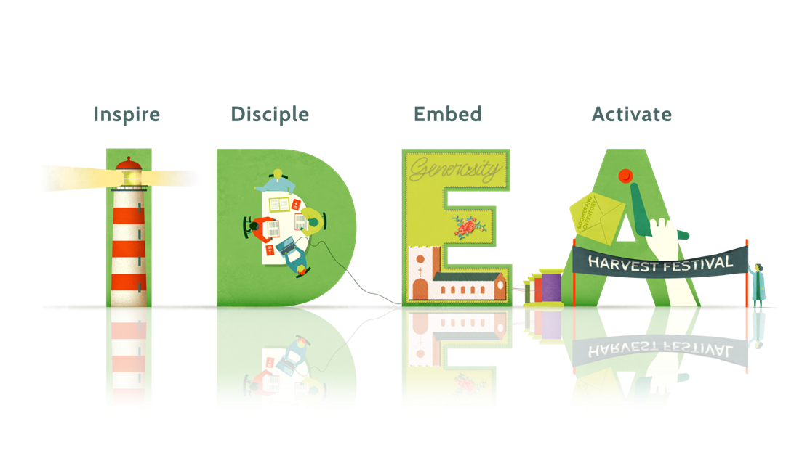
MINT / IDEA
Notes:
Before going further, it may be helpful to give a brief overview of the MINT and IDEA frameworks.
The Church of England uses the MINT and IDEA frameworks as useful anchors for thinking about generosity. They are informed by research, including the Anglican Giving Survey and the Stewardship Generosity Report, and they help parishes approach these questions in a more structured way, whether they are starting out or developing an existing giving programme.
MINT pulls in concepts linked to types of givers, building trust, communication, and are in some ways the first steps towards a generous culture. The practical elements of mechanisms to enable giving, the essential communication of needs and impact of giving – all of these are linked to identified types of givers and how to access them, and the linchpin – Trust – people will give if they trust the person/institution they are giving to.
If MINT helps with some of the practical foundations for giving, IDEA helps churches think about the wider culture of generosity. It starts from the belief that God is generous, and that Christian generosity is rooted in discipleship and response.
IDEA encourages churches to inspire through leadership, disciple through teaching and learning, embed generosity in worship, ministry and planning, and activate generosity by giving people real opportunities to respond. The emphasis is not just on initiatives, but on forming a church culture in which generosity becomes part of everyday life and faith.
To summaries:
MINT helps churches think about the practical foundations that support giving well. IDEA helps churches think about the deeper culture of generosity they are seeking to grow.

Slide 8

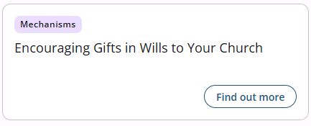
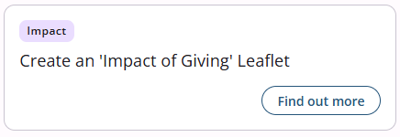
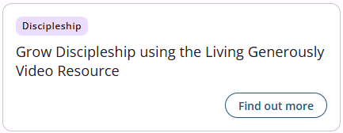
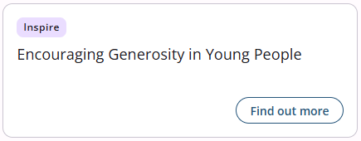
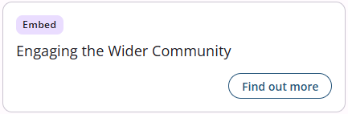
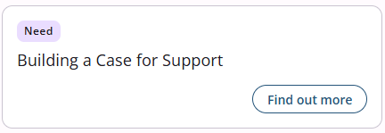
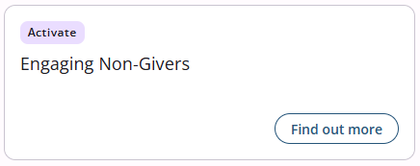
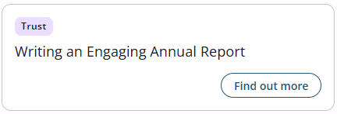
Notes:
The reason I bring up the Generosity Review and the MINT and IDEA principals is that they are embedded into the
second component of Cornerstone “Pathways”
The information a church receives through “Insights” helps it see where attention is most needed.
The “Pathways” then turn that into practical action.
There are over 50 pathways on the platform, with more being added, and churches can use as many or as few as are helpful.

Slide 9
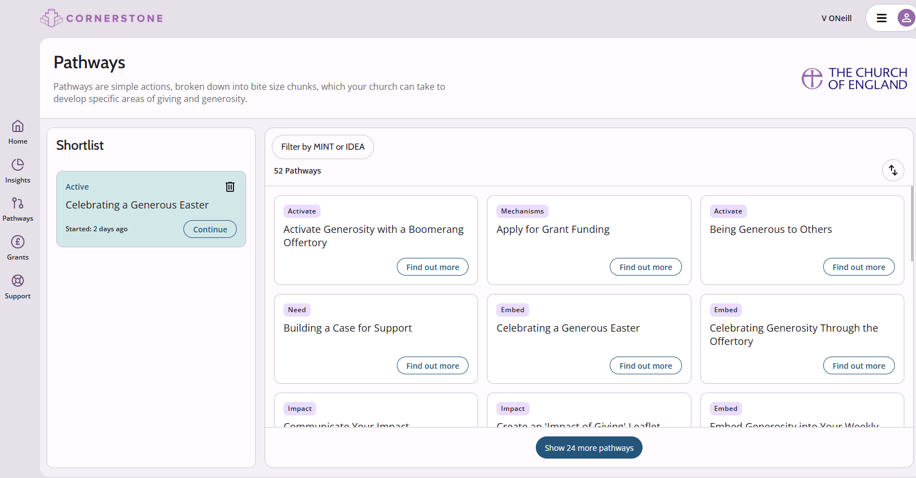

Notes:
Each pathway focuses on one topic and breaks it into manageable steps, with templates, videos and guidance included.
The pathways are grouped around the MINT and IDEA principles,
so churches can choose what best fits their present situation, whether that is strengthening mechanisms for giving or focusing more intentionally on generosity.
(MINT – mechanisms, impact, need, trust)
(IDEA – inspire, disciple, embed, activate)

Slide 10
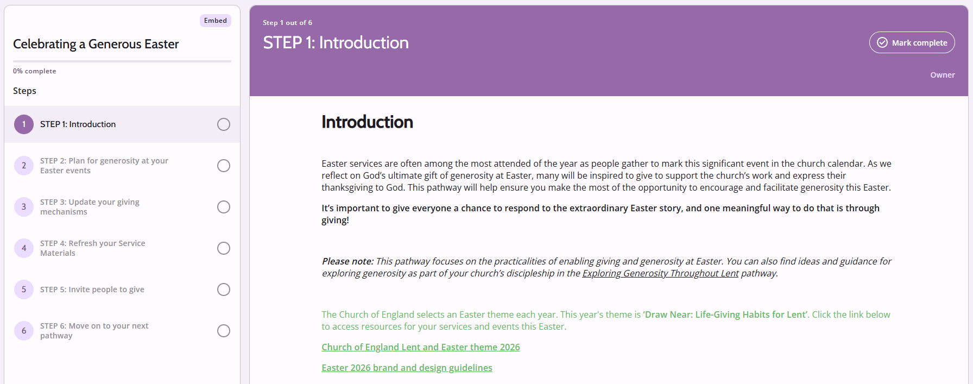
Notes:
As an example, this pathway focuses on celebrating Easter.
You can see that it breaks the work into clear steps.
It prompts churches to think ahead about generosity in the context of services and events,
to review practical arrangements,
and to check that giving mechanisms and digital links are working properly.
Some of these tasks may sound obvious,
but setting them out clearly helps churches prepare systematically and avoid missing practical details.

Slide 11
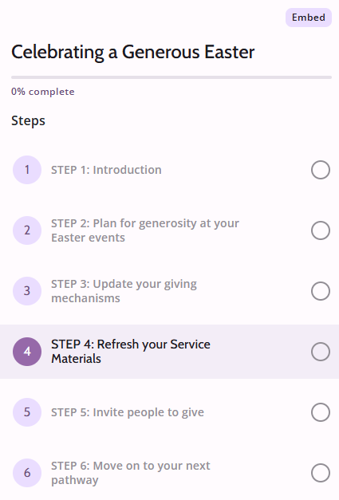
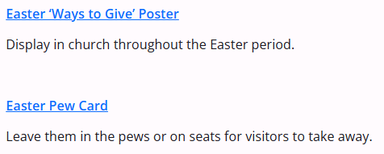
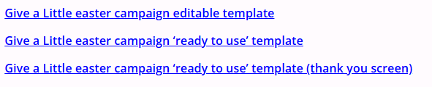
Notes:
This step shows the downloadable templates and resources included within the pathway.
These are there to give parishes a practical head start — for example posters, pew cards and campaign materials.
Using these saves time and reduces the need to start from scratch.
You can see that on Step 5 the “invitation to give” also reminds churches of the importance of explaining the impact of giving clearly, so that people understand what their support enables.

Slide 12
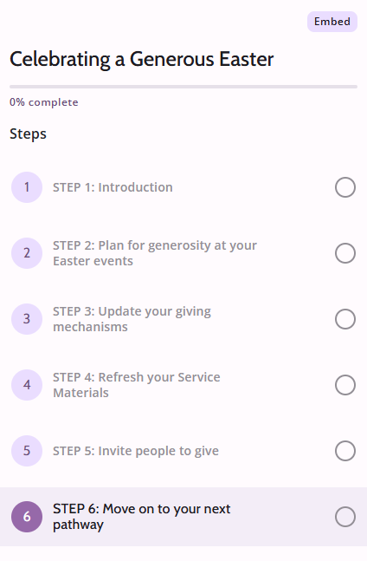
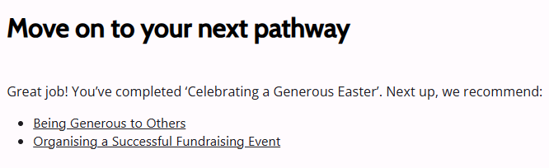
Notes:
Once a pathway has been completed, it is stored within the church’s profile, and the platform can suggest a next pathway that may be helpful.
That means churches are not simply completing one-off tasks, but can build a more joined-up approach over time.

Slide 13
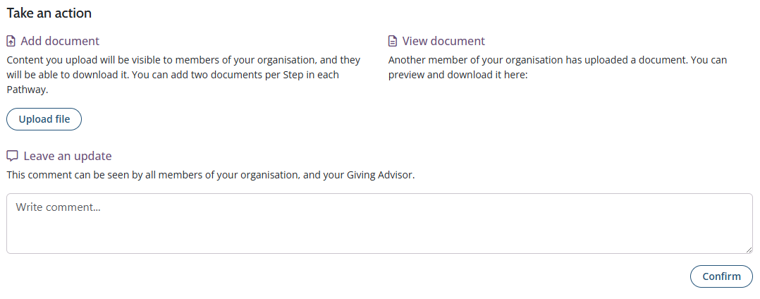
Notes:
The Cornerstone “Pathways” also support collaborative working by giving parishes a shared space to upload documents, draft materials and leave comments as a project develops.
This makes it easier for church teams, volunteers and advisers to review materials, share feedback and keep everything in one place.
That can be particularly useful for projects such as generosity campaigns, where several people may be contributing to the same piece of work and are not able to meet in person regularly.

Slide 14

Notes:
One of Cornerstone’s great strengths is its grants database.
All churches have free access to a curated database of around 1,000 grants,
covering a wide range of purposes, values and locations.
It is searchable and filterable.
It is updated weekly,
giving parishes a strong starting point for identifying funding opportunities.

Slide 15
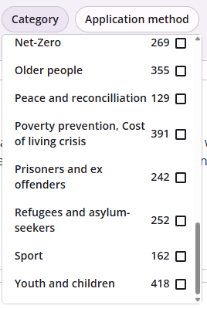
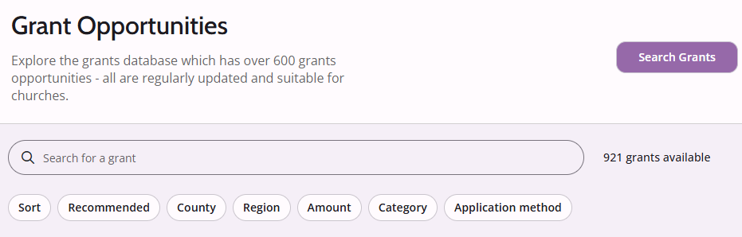
Notes:
Many parishes know what they need funding for, but not where to begin.
The database helps narrow the search quickly,
so that churches can focus on realistic funders rather than searching blindly.
If a church is looking for support for building work,
accessibility improvements
or redevelopment, it can filter by project type, location and application method.

Slide 16
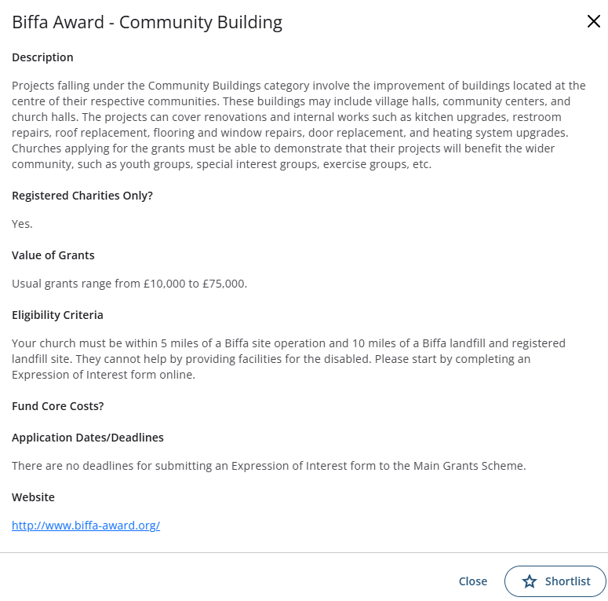
Notes:
Churches can read full details for each grant, shortlist suitable options, and track progress from application to outcome.
That brings more order to the process, which is especially useful where administrative capacity is limited or where no one on the team has much grants experience.
We can already see the value of that in practice:
Kingswinford Parish reported that £65,000 across two grant applications came through funders identified using Cornerstone.

Slide 17
Contact your Area Giving and Finance Adviser:
Two Cities: Jagoda Keshani jagoda.keshani@london.anglican.org 020 3837 5111
Stepney: vacant catherine.stephens@london.anglican.org 020 3837 5050
Kensington: Victoria ONeill victoria.oneill@london.anglican.org 020 3837 5137
Edmonton: Julie Churchyard edmontonAFA@london.anglican.org 020 3837 5015
Willesden: Catherine Stephens catherine.stephens@london.anglican.org 020 3837 5050
Notes:
To summarise - Cornerstone supports parishes in four practical ways:
It gives clarity by helping church leaders understand their giving culture and financial picture.
It gives structure by breaking the generosity journey into manageable “pathways”.
It saves time through ready-made resources, templates, dashboards and guided processes
And it helps churches find funding through a grants tool that allows parishes to search, filter, shortlist and track applications more systematically.
We will be launching Cornerstone across the Diocese in the autumn, with events to introduce the platform more widely.
In the meantime, any parish that would like to explore it further, or sign up, can do so by contacting their Area Giving and Finance Adviser.

Slide 18
QUESTIONS?
Notes:
Thank you and I would be glad to take any questions.

