Slide 1
Fundraising & Grants
Nicole Crockett - Head of Development

Slide 2
Why Fundraise?
Why are you fundraising?
What do you specifically need funds for?
To further your mission?
To do more with your local communities?
To repair/improve your church/church hall?
To move towards Net Zero Carbon?

Slide 3
Creating a Fundraising Plan
A Fundraising Plan provides a route map shows how you are going to fund your project. It typically outlines:
The project or service you need the money for
A budget showing how much you need to raise
A timetable for raising the money
Who is going to fundraise
Which funders you intend to approach

Slide 4
Where to Begin?
To convince a funder of your need you should:
Define your project
Gather evidence that it is needed
Establish how much your project will cost, when you will deliver it, identify any partners you can work with.

Slide 5
Who needs to be involved?
Fundraising requires time and focus. Who in the parish can do this?
Clergy/PCC/Congregation?
Set up a fundraising committee?
Could you appoint a fundraiser?
Are there local partners you can work with?

Slide 6
Where to look for funding
Parish Congregation (events, sales, fetes, quiz nights?)
Local authorities and funding bodies
Trusts & Foundations
National Lottery bodies
High Net Worth Individuals

Slide 7
Consider funding opportunities
Wide range of funders & funding programmes - National Lottery, Trusts and Foundations, Livery Companies, Local authorities, Landfill Trusts, Corporate bodies…
As part of your Funding Plan you will need to:
Research funders
Match your project to their interests/funding criteria
Consider application deadlines and decision dates

Slide 8
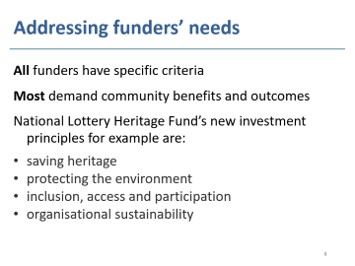
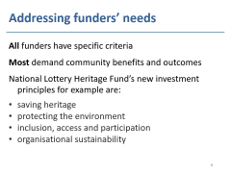
Addressing funders’ needs
All funders have specific criteria
Most demand community benefits and outcomes
National Lottery Heritage Fund’s new investment principles for example are:
saving heritage
protecting the environment
inclusion, access and participation
organisational sustainability

Slide 9
NHLF: Options and Phases
Heritage 2033 programme grants - £10k to £10m
Heritage Grants £10k to 250k
Small projects and project development work
Heritage Grants £250k to £10m
Large capital projects – a two-stage process
Development Phase - 10% of budget to plan project in detail
Delivery Phase - Delivering a capital project and activities

Slide 10
Match Funding
Nearly all projects will require a matrix of funders to deliver the outcomes you want.
Most funders expect you to raise match funds
The Heritage Fund Minimum 5% - 10%
National Churches Trust 50%
Benefact Trust 30% (in place before applying)

Slide 11
Collaboration and Partnership
Partnering with others can be part of your project journey adding capacity and ensuring sustainability
Partners might include: local community groups, NHS or health groups, wellbeing groups, support groups, schools or youth groups…
Other parishes – can you work together to create a package of support for communities?

Slide 12
Funding Carbon Net Zero
NZC 2030 - Creating a Greener Church
Energy Audit – City Bridge Foundation (closed 26)
Church of England – opportunities for Top 600 Emitters (Energy audits, quick wins, capital funds) (Fill in your EFT to qualify and join Eco Church)
Local Authorities – Carbon Levy Funds
Landfill Community Trusts - www.entrust.org.uk

Slide 13
Fundraising Policy
A Fundraising policy outlines the process you follow when considering whether to seek or accept funds. It should
Reflect the ethical standing of your organisation
Do nothing to bring the organisation into disrepute
Avoid favouring or discriminating against one group of users or doners over others
Abide by the universal principles of honesty, respect, integrity, empathy, and transparency.

Slide 14
Resources
Church Grants (Subscription £49 p.a.)
https://www.churchgrants.co.uk
Chartered Institute of Fundraisers
https://ciof.org.uk/
Churches Together
https://ctbi.org.uk/
Cornerstone
https://www.churchofengland.org/resources/
National Lottery Heritage Fund
https://www.heritagefund.org.uk/

Slide 15
LDF support
Advise on project development and phasing
Advice on building projects and Faculty
Advice on Net Zero Carbon pathways
Advice on Fundraising
funding@london.anglican.org

