Slide 1

Building a generous church
Notes:
Building a Generous Church, easier said than done right?
A generous church is built on culture not campaigns, so today we’ll be looking at how you can try and change that culture in your parishes. We’ll walk through practical starting points, to identify how you can enable giving in your Parish. Then we’ll move on to encouraging generosity, how you can build and sustain momentum with giving in your church. And I’ll show you a range of resources that are available to you to support you through this journey.
One of the hardest aspects of building a generous church is the difficulty so many of us still have talking about giving and generosity. It can feel wrong and unnatural, especially when we grow up being told never discuss politics, religion or money. Though we seem to do alright with ignoring the religion part of that old adage.
So how can we break down the barrier and open up the conversations?

Slide 2

Notes:
A good place to start is The Generous Church Check-Up. It’s a great way to get people talking about how you encourage giving in your church and wider community. It’s a short questionnaire that encourages self-reflection on aspects of generosity in your church, from practicalities you may or may not have in place, such as “do we make the most of gift aid?”, to where you rate the culture of generosity in your church.
It focuses on celebrating successes and identifying areas of improvement and is designed to create a plan for the coming year, without placing too much of a burden on the leadership of your church.
This is crucial because to start building generosity, you need to know what your foundation is. You need to know where you are as a parish, you don’t want to waste time focusing on something that won’t actually benefit you.
It also means the conversation begins with the PCC. The PCC are key leaders in the church, they need to go through the cultural transition first, so that they can then model these behaviours to the rest of the congregation.
It’s a short session that can be held within a PCC or Leadership team meeting.
So, once you’ve done your check-up, and are getting your PCC on board, you then need to look to the wider congregation.

Slide 3
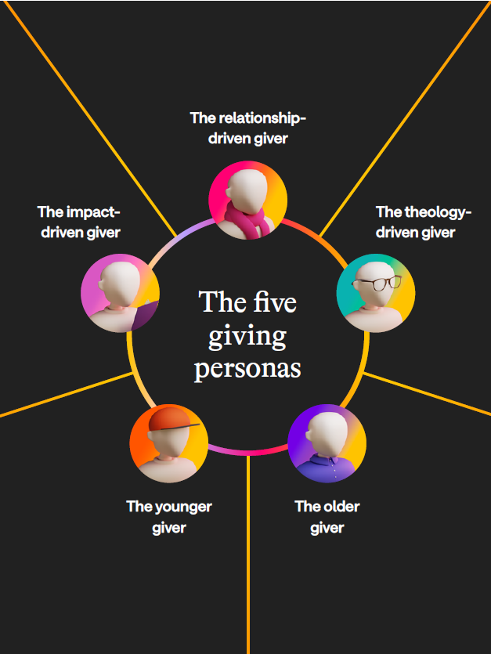
Notes:
When you’re talking to your congregation about giving, you need to understand your audience. Who are they? What drives them? What puts them off? How can you best reach them?
The Stewardship report identified patterns in giving that could be broken down into five specific personas.
These different types of givers will each have different motivations, barriers and opportunities for engagement.
For example the impact-driven giver is motivated by a desire for maximum effectiveness and measurable impact and encouragement from seeing evidence that gifts produce real change. Their barriers are appeals that are vague, emotive or lack clear outcomes, and poor transparency or failure to report back.
Alternatively the theology-driven giver is motivated by a conviction that everything belongs to God, we steward, not own, and they see giving as worship and discipleship. Their barriers are mission drift: strong social good, but weak or unclear Gospel focus.
And if we look at younger and older givers, younger givers like to see stories of impact, putting faces and names to giving, not just numbers. But older givers find emotional appeals a greater barrier.
This is where really knowing your congregation matters, you need to know the best way to reach the people you are appealing to, to get the best results. If you have a congregation full of relationship-driven givers, but all your appeals are targeted around finances and figures, then you will not connect with them.
Now of course it’s highly unlikely that your whole congregation will be made up of one type of persona. So this means it can’t just be one single voice always doing the talks on giving, we need to play to different people's strengths. I’m sure a talk from the treasurer would have great results with the impact-driven givers, but if you want to target the theology or relationship-driven givers then perhaps your Priest is better placed.
There will be nuance within these personas, and people will sit across different categories, but it highlights how important it is to deliver the message in a variety of ways.

Slide 4
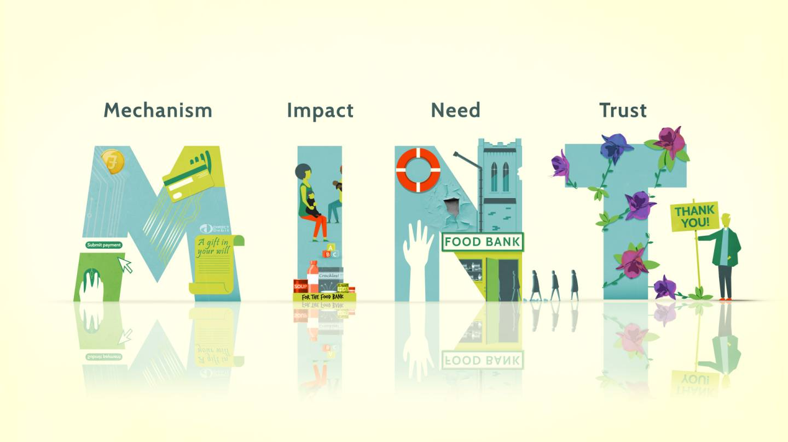
Enabling Giving
Notes:
Once you’ve identified your culture and your congregational make up, you then need to think about how you can enable giving.
If you want to increase giving in your church, then you need to create the right environment for people to give.
There are four areas to focus on, making the acronym mint.
You have to have the right mechanisms in place for giving, such as direct debits, contactless payment, gift aid etc.
The easier it is to give, and the more ways we offer to give, the more likely people are to give. The way people use money is changing, and that means the way people give is changing too, and we need to acknowledge that in the mechanisms we offer.
Show the impact of people’s giving, how it enables the church’s ministry and mission. Think of impact reporting as the stories people tell about what your church has done for them.
When we try and encourage giving we often talk about costs, but that can be pretty dry and often makes people think their giving is insignificant in comparison to the overall costs of ministry and mission. Instead of talking about costs, we should talk about our impact, about how you are realising your vision as a church, such as bringing more people to Christ, supporting vulnerable people, or creating a sense of community cohesion in the parish.
Explain the need for people to give, so they see how important it is that they do. Explaining need is a key part of the giving mix and can’t be neglected. People may find it easy to give, they may see the impact gifts make, they may trust the church with their money, but if they do not see the need to give, then often they will not.
And finally build trust, so that people have confidence that the church will spend their gifts wisely and well. Trust takes time and patience to build. It takes energy and effort. But it can also be lost incredibly quickly. As a result, we must act ethically and honourably, ensuring that the way we ask for support, and the way we spend what is given, is entirely consistent with our faith.
And we must tell people what we’ve done. Regularly explain to givers what was given and how it was spent, let them know that we have spent money on the things that are important to our church and community.
If you have these four things in place, you will have created the best environment for people to give. And there is a multiplier effect with these four areas, the more you develop one, the greater the impact of the work you do in the other areas.
Ok, so we’ve identified our current culture, know our congregation, and have everything in place to enable giving, what next?

Slide 5

Encouraging Generosity
Notes:
Next we look at encouraging generosity.
This is where the real hard graft comes in, but also perhaps the most encouragement and fulfilment.
Encouraging generosity is where our stories, our connection and our theology come into play, all going towards growing a generous culture.
To cultivate a generous culture, there are four areas we need to focus on.
Inspire people through generous leadership and celebrating generosity within the life of the church. Everyone needs inspiration to live generously, to be given hope that we can grow in generosity, and to grow our faith in our generous God.
Generous churches have generous leaders. This isn’t just about lofty speech, helpful as that is, it is about looking out for generosity and celebrating it when found. It’s about regularly thanking people for all the generosity they show. And when I say regularly, I don’t mean once a year in a giving talk, but every time the church comes together. This generosity can take many forms, yes giving money, but also giving time, our possessions, giving freely of our talents and abilities, and we need to celebrate each and every one of them.
PCCs have a crucial role to play in inspiring generosity. In what ways does the church financially support others, and is this explained to church members? It is important to explain to church members how the church financially supports others through their giving. PCC members can be crucial in setting the generous culture, in showing others the generosity they want to encourage. The amount is not as important as the fact that it is committed and regular, and PCC members have a crucial leadership role to play with this.
We can also inspire people’s generosity through the plans and vision to grow our church’s ministry and mission. We should be prepared to look honestly and constructively at our plans and ask whether they reflect God’s generosity and the generosity he is calling us to.
Disciple members, through resources, teaching and learning, so people can grow in an understanding of God’s generosity towards them, and how they can live generous lives.
Generosity is a spiritual gift, and we need to encourage people to seek this gift as they grow in their faith.
We need to encourage people along a journey that starts with “how much of my money do I give away?” to “how much of God’s money do I keep?”
We need patience, kindness and love when encouraging people’s generosity, and to provide people with the space and time to explore what God may be asking them to do.
There are a variety of resources available to support you in this discipleship.
Embed generosity in the life of the church, generosity is far too important to only be mentioned once a year on a Giving Sunday.
Generosity needs to be woven into all the life of the church, embedded within our ministry and mission, and celebrated and encouraged whenever we gather together. This can be as simple as thanking God for his generosity during the intercessions, or notices can be a great opportunity to highlight the generous initiatives and activities within the life of the church.
Generosity needs to be embedded within our mission plans and strategies, not just implied but named. We need to be clear about the ways we want to develop our generous lives, and the plans we will put in place to achieve this. We need to ensure that new members of our church understand how important it is for us to be a generous community, and to encourage them to be a part of that.
Embedding generosity in these ways enables the culture to change, and for it to become part of the character and behaviour of our church.
Periodically it is really helpful to focus on generosity over a period of weeks so that we can all see its importance to the church’s ministry and missions. Giving programmes can be a really helpful way to do this. They offer numerous resources for services and activities, ordinarily can be accessed for free, and there are different ones depending on your church context.
Activate generosity, by providing opportunities for people to grow in generosity and apply what they have discovered.
People often want to live a more generous life, but they don’t know how. You can pray about it, think about it, learn about it, hear about it, see it and admire it – but that does not mean you necessarily will do it.
Generosity doesn’t happen by accident, or without encouragement, if you read Archdeacon Catherine’s piece you will know that actually sometimes we do just need to ask.
We need to provide activities to grow generosity and enable people to flourish.
This is particularly true for younger people, who often show incredible generosity and a desire to live generously, and can grow if given the right encouragement and opportunity.
Our churches must demonstrate generosity for people to learn how to be generous and lead generous lives. There are a a number of ways that this can be done, and because every context is different, different churches will do this in different ways. But the crucial bit is that something is done.
So overall “IDEA” helps you to grow your culture.
Understanding how to grow a culture is critically important. This isn’t about delivering a series of initiatives, but about changing our way of being and behaving. It requires patience, commitment, determination, and above all else, prayer. Leadership is crucial, but this is something that all need to be committed to so that we become the generous community we are called to be.

Slide 6

What Next?
Notes:
I’ve just chucked a load of information at you, and you may be sat here thinking this is a lot. How are we going to manage this?
Well first up, you’re not alone in this. Myself and the rest of the Area Giving and Finance team are on hand to support you. We can help you decide which resources are best suited for your church. If you need an independent voice we can come and facilitate starter sessions for you. We are always on hand to offer help and guidance, all you have to do is reach out and ask.
And while I’ve mentioned some resources today, this is only the tip of the iceberg. There’s a whole section on the Church of England website dedicated to Building a Generous church where you can find everything you’ll need.
I’ll highlight some examples here now

Slide 7

Notes:
Living Generously is an eight session course in which Director of Giving, Jonathan de Bernhardt Wood, explores the simple, powerful moment in which Mary, a friend and follower of Jesus, displays the kind of astonishing generosity God Himself pours out on us. Each session has a video and accompanying study guide, which walks you through the different aspects of generosity. Being generous with time, with attention, with possessions.
Because yes increasing generosity in giving financially is important, if we want a true cultural change then we need to look at all aspects of our lives and how we are giving.

Slide 8


GENEROSITY FIKA
Notes:
The Generosity Fika is a half day programme, for small groups to explore God’s generosity to us, biblical generosity and generosity around the world. Through short films, reflections and discussion we can be inspired and encouraged to live more generous lives.
Fikas can be an enormously effective way of developing a generous culture within your church.

Slide 9
Generous Church Review
Notes:
Then there’s the Generous Church review.
This is a resource for your PCC to meet and reflect on your shared experience of generosity in the life of your church. By working through the cards in the pack provided, you will look in depth at what generosity is, consider what you are already doing well, and where you could improve and grow.
You should come away from your session with a vision of how God is calling you to be generous as a church and the steps you need to take to get there.

Slide 10
Key Takeaways
Identify your starting point
Enable Giving
Encourage Giving
Utilise resources available
Notes:
Hopefully today has given you food for thought on how you can build a generous church.
The key takeaways from this session should be
Identify your starting point. What are we doing well? Where are our opportunities? Who is our congregation?
Enable giving. Do we have the right mechanisms in place? Have we identified the needs? Are we making and communicating an impact? Do our community trust us?
Encourage giving. Are we inspiring our congregation? Are we enabling discipleship? Are we giving opportunities for people to be generous?
Utilise the resources available. Which programmes would work best in our context? What will help us best change our culture? Have we made the most of our Area Giving and Finance Adviser?
All the aspects I’ve spoken about today were covered in more detail in our weekly zoom sessions run throughout March. These were recorded and will be put onto the Diocesan website after Easter.
The most important thing to remember throughout this whole process. Giving is a part of our faith, and a key way in which we can show our love to God. To follow Christ is to hold nothing too tightly – our generosity becomes the evidence that we trust God more than our possessions.

Slide 11
Building a generous church
Questions?

