Slide 1


Common Fund
2026
Notes:
AD
Welcome – thanks, introductions, aims

Slide 2

Beginning a conversation…
Notes:
AD
As I said last year, two decades of DoL CF presentations for me = What’s the number?!
But, Common Fund isn’t meant to be about demand and response – it’s meant to be a conversation
About how we fund local church ministry and mission across the diocese
An, at its best, it’s a parish-by-parish, BMO-by-BMO conversation through the year
But with a particular focus as we head from now towards the autumn
TODAY – we want, once again, to remind ourselves what CF is (and isn’t)
…to talk about how we hope PCCs will decide on contributions
…lay out what it helps fund
…and explain what resources are on offer as PCCs meet to decide

Slide 3
Parish contributions, alongside substantial funding from the London Diocesan Fund…
What is The Common Fund?
Notes:
AD
So, what is CF?
Parish contributions, alongside substantial funding from the London Diocesan Fund…
…worth just noting that – The Common Fund is a financial collaboration between the local and the diocese
…born out of conviction that we may not have enough on our own, but together we have enough to do what God is calling us to
Strong contrast to either congregationalist (sink or swim) or federalist (send a bill) models

Slide 4
…making possible the provision of parish priests, vicarages, parish support teams, and training the next generation of clergy.
What is The Common Fund?
Notes:
AD
…and the focus of The Common Fund is almost entirely local
…making possible the provision of parish priests, vicarages, parish support teams, and training the next generation of clergy.
We believe that the single biggest thing we can do to ensure the health and vitality of our local churches, when it comes to money, is to finance parish priests, their housing and to train their successors… whilst providing the professional support PCCs need in this age of regulation and governance

Slide 5
The biblical principle of mutuality between churches supporting those…
…in our poorest communities
…going through difficult financial times
…starting new mission initiatives
according to means and need.
(2 Cor 8 & 9)
What is The Common Fund?
Notes:
AD
But, just to reiterate, the theological and relational genius – and I think it is genius – of the CF idea is that this isn’t
…sink or swim on your own
…nor a bill/invoice you have to pay the centre
This is about mutuality – churches receiving according to their need and contributing according to their means
It means
We don’t retreat from the poorest areas
We support churches in financial crisis – including when almost everyone… in Covid
And we can start new things, knowing there’s time to build

Slide 6


Notes:
AD
…and all of this for our common vision – for every Londoner to encounter the Love of God in Christ
So how much should you contribute to CF?
Three things we’d suggest you bear in mind

Slide 7


Deciding on your contribution…
Context
Suggestion
Benchmark
Notes:
AD
The first is, crucially, your local context – there is no ‘standard’ figure for all (that’s one of the reasons we’ve changed the name away from a ‘parish standard cost’ – there’s no such thing as a standard parish!) – consider your resources, your commitments, your potential giving and income, as well as your financial needs.
The second is a suggestion – it’s something we started newly last year, at least from me, and people seemed to find it helpful. I will be writing a letter… based on what we think we know, suggesting… not a demand or an invoice, but I hope a helpful challenge
Finally, there’s a benchmark – what we used to call the “Parish Standard Cost” – a way of putting a real number on what it costs… [next page]

Slide 8
The London Ministry Cost Benchmark
An indicative figure showing what is budgeted in 2026 for the direct cost of clergy and the average costs of housing provision, parish support teams, and the training of future clergy.
Notes:
AD
…to provide stipendiary clergy, their housing, professional support for PCCs and to train the next generation of parish priest
We’re calling it the London Ministry Cost benchmark – and it’s based around the draft budget for next year
so it’s not an invoice or bill
nor a guilt trip device
and certainly not a figure artificially inflated to get everyone to pay more
It’s a benchmark cost to help PCCs decide what to contribute to the CF

Slide 9
The London Ministry Cost
£99,880
Parish and clergy support
£19,400
Training new clergy
£46,320
£11,180
Stipendiary clergy
£22,980
Clergy housing
Notes:
AD
And this year’s cost benchmark is £99,880
…yours may be lower or higher, if you don’t have a stipendiary priest, or you have more than one house, but that’s the headline figure
…and for those of you with long memories, or a head for figures, you may have spotted something unique
…last year’s cost figure was a rise of 9.5% over the previous year – as we caught up with maintenance costs, and responded to inflationary pressures, as well as showing and including some of the costs we had artificially hidden
…this year it has actually (for the first time ever I think) gone down, only by £100, but nevertheless, I hope you agree that’s good news.
That flat cost benchmark reflects a planned budget where we have really held tight to costs, taken into account the likely removal of our contribution to national church support, and seen vicarage maintenance costs reduce as we begin to catch up on repairs
[click] and this is how it breaks down – name… and roughly
Now AGFA is going to walk us through each of those four cost areas in the benchmark figure
AGFA
As the AD has said, the London Ministry Cost benchmark figure is made up of four cost figures representing:
The costs associated with a fulltime stipendiary priest
The costs of providing a parsonage for that priest
Training future clergy costs
and parish support costs which every parish shares
If your parish has a different combination – for example, two CF priests, or if you provide the housing directly, then those costs are calculated accordingly.
The cost figure appropriate for every PCC will be sent out in the letter being sent to each parish in the next few days.
It’s worth emphasising what [AD] has already reminded us of. This figure is not a demand for money, nor a blanket expectation on every PCC, and certainly not a tax we impose – it is information about the costs which the LDF underwrites in each parish and what we hope you will bear in mind when considering how much you can contribute to your own costs of mission and ministry.
There is a handout available for all PCC members with a detailed breakdown of everything these costs cover, but in the meantime, this short presentation will give an overview.

Slide 10
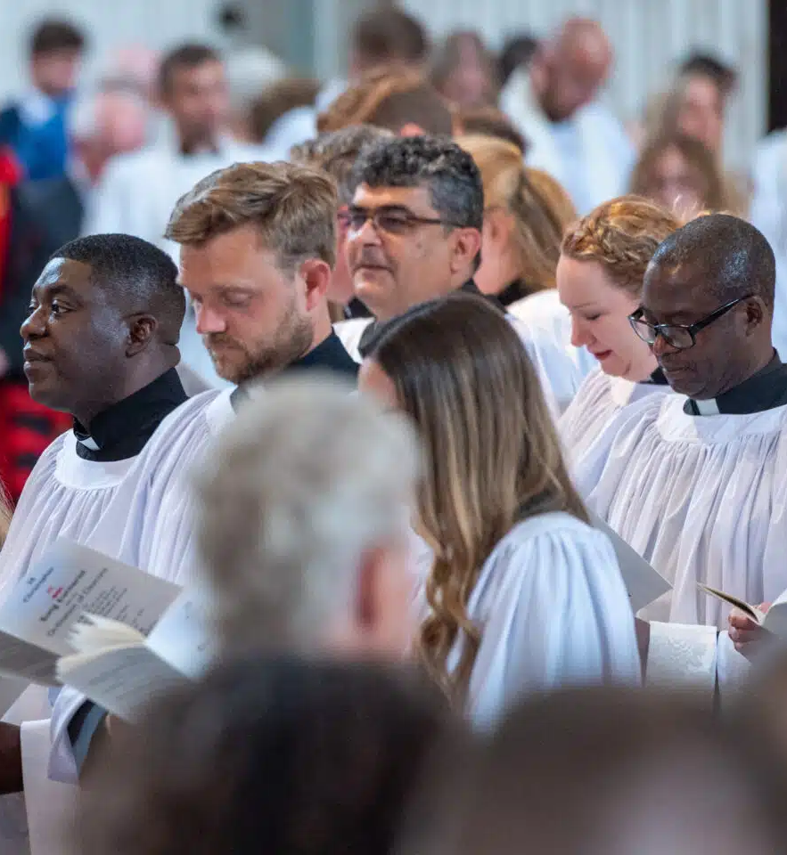
Stipendiary clergy
Stipend
Pension & NI
Council Tax
Moving grants
Vacancy saving
£46,320
Notes:
AGFA
This first part of the benchmark, of just over £46k, or around 46% of the whole, relates to the more direct costs of having a parish priest. This includes:
Paying their stipend, taking into account what we predict will be a 6% increase into 2026, NI costs, which have risen, and pension contributions
We also include an average Council Tax bill, since the diocese pays that for a stipendiary priest even if we do not own the parsonage, plus figures that average the resettlement grants for when clergy move on
…this cost figure is then reduced by taking into account the average number of vacancies across the diocese. That means that the PSC doesn’t reduce when a parish priest moves on, since every parish benefits from this every year and Common Fund payments continue as usual during a vacancy.

Slide 11
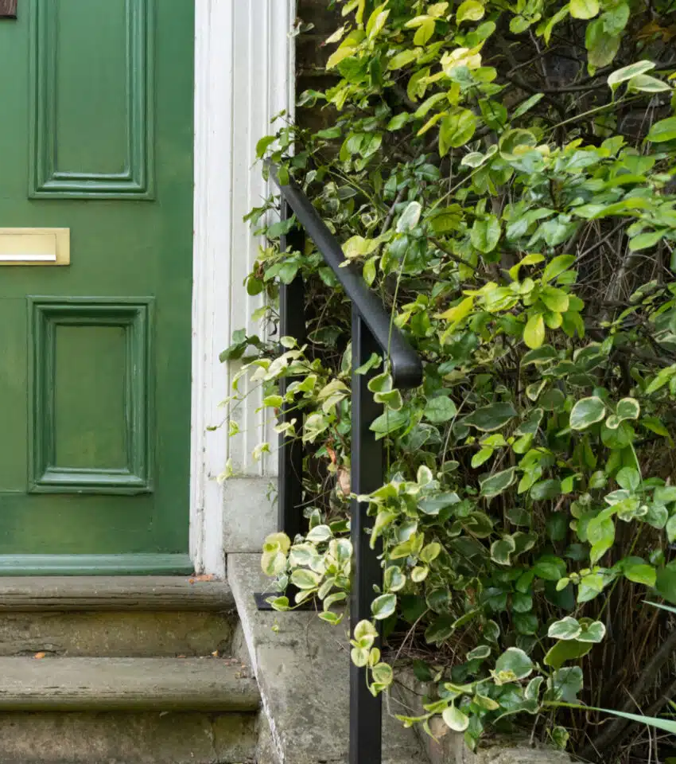
Clergy housing
Maintenance
Safety
Insulation
Improvement
£22,980
Notes:
AGFA
This part of the cost, of just under £23k, which is the equivalent of around £1900pcm, is the average cost of providing a vicarage, or parsonage, for the parish priest.
Clergy housing come in all shapes and sizes and need widely differing maintenance costs across their lifetime, so we average out the cost of making sure our clergy have places suitable for life and ministry across the parishes rather than weigh a particular parish down with the cost of replacing a roof or fitting double-glazing.
Housing costs include matters such as:
Maintenance
Our duties as landlords, such as gas safety, asbestos, electrical checks
Improve the energy efficiency of clergy homes to reduce the cost of heating for clergy through insulation, double or secondary glazing etc. – which also helps us towards our netZero goals
And also pays for upgrading vicarages, usually when a new vicar is arriving
This is a slightly lower figure than 2025 and represents exceptional value for money in London for providing a “working home”. The average rental cost of a minimum vicarage size house in the Diocese is £45,000.

Slide 12
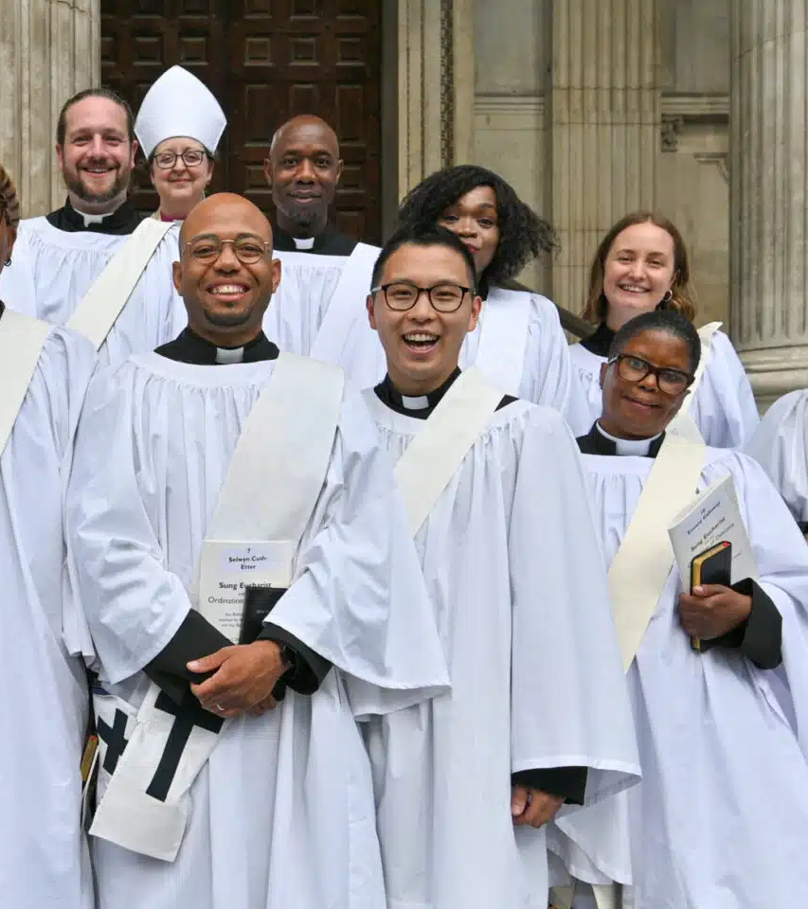
Training new clergy
Ordinand support
Title Posts (“curacies”)
£11,180
Notes:
AGFA
11% of the benchmark cost figure, or just over £11k, relates to the training of a new generation of parish priests.
We contribute as a diocese together to
the support of ordinands in training,
and the provision of curacy training posts.
We recognise that most parishes won’t be in a position to receive a curate themselves, but these costs are about training someone who may be your next vicar, ensuring that generations to come have the ministry and leadership of a trained and experienced parish priest.

Slide 13

Parish and clergy support
Safeguarding
Parish Property
Fundraising & Finance
Youth & Children
Area Teams & Grants
Law, Governance & HR
National Church
+ Charity Admin (<7%)
£19,400
Notes:
AGFA
The final part of the London Ministry Cost benchmark relates to support costs for local parishes and clergy, plus a small amount to run the charity which is the London Diocesan Fund
There are many ways in which the Diocesan support teams provide professional advice, encouragement and help directly to the local church. This includes:
Our safeguarding advisors
Parish property support and fundraising
Area Finance Advisers and Archdeacons
And professional advisers and trainers covering youth work, HR, governance and legal support
The Common Fund means that every aspect of this diocesan support is free at the point of use, meaning that a parish with a major safeguarding issue one year, for example, isn’t suddenly having to find extra funds to pay for professional advice.
We also show a part of that figure, less than 7% of the whole cost figure, is spent on the administration of the diocese as a charity. This figure compares very favourably indeed with other similar charities, where the benchmark figure is often 20% or more. We aim to be as lean and efficient as possible, so that as much of what we raise can go directly into the life of the local parish.
You might notice that this year there is no figure representing our payment to support the National Church Institutions – last year this was around £2k as part of this benchmark. That’s because it looks like General Synod will be voting to end this contribution and fund national church work in other ways. That has clearly helped keep our benchmark figure down.

Slide 14
The London Ministry Cost
£99,880
Parish and clergy support
£19,400
Training new clergy
£46,320
£11,180
Stipendiary clergy
£22,980
Clergy housing
Notes:
AGFA
So, the London Minstry Cost Benchmark for 2026, gives an average of what the London Diocesan Fund is committing to spend in ordert to support the mission and ministry of a local church with one parish priest, one vicarage, a range of important support services and a contribution to training priests of the future

Slide 15
>80%
Stipendiary clergy
Training new clergy
Clergy housing
Notes:
AGFA
…and perhaps it’s worth noting, favourably I hope, that some 80% of that cost relates to our commitment to clergy ministry – both making possible full time stipendiary ministry, and providing homes for parish clergy, as well as training parish priests for years to come.
As I said at the beginning, there is a detailed document available for PCC members on the diocesan website going to into much more detail on each of those four cost areas – and both AD and I are happy to respond to questions by email in the coming weeks.

Slide 16
What is asked of PCCs?
To contribute as fully as possible to your own share of costs…
…and consider supporting other parishes too.
Notes:
AD
So – summarise what we’ve said so far…
CF makes it possible for us, together, to fund… across… receiving according to need, contributing according to resources
We’re asking, as every year, PCCs to contribute as fully as possible to your own share of the costs… and if that is within your reach, then to consider supporting other parishes too.
But we have a unique challenge this year – and it’s for a nice reason for once
Although 9.5% was a big rise last year, it made at least part of the conversation (about how much we hoped PCCs might increase their contribution by) a very obvious and simple one…. The need for an increase was really obvious
Not so much this year… so why do I ask every PCC who can possibly do so, to consider contributing more in 2026 to this year?

Slide 17
Context
Suggestion
Benchmark
Challenge
Gap met from diocesan reserves
£5.2m
£9.5m
£25m
Parish Contributions to Common Fund
Other Diocesan income
Notes:
AD
Well, alongside considering context, suggestion and benchmark
…there is a real and increasingly urgent challenge facing the whole diocese
Represented by the pie chart – shows where the income comes from to meet the expenditure of the diocesan fund on parish ministry
Parish contributions… 63% of the whole
Other dio income… 24%
Leaves a really significant gap
Currently being met by using capital and selling assets
Why? Because we believe in the local church, because we will continue…
But it can’t last forever…
Using capital lowers future income
And also runs out eventually
A significant change is parish contributions – used to be ~70% of the cost coverage,… which in fact neatly covered the whole cost of stipends and clergy housing

Slide 18
Context
Suggestion
Benchmark
Challenge
Gap met from diocesan reserves
£5.2m
£9.5m
£25m
Notes:
AD
And of course in years where the budget goes up by 4 or 5% in a year that gap is not likely to narrow very much
But in a year like this, we’ve got a real opportunity to make up ground
So, where a parish is able to make an increase in its contributions, it will make a real difference both to the coverage of their own costs… and also to the deficit we’re carrying together as a diocese
This year is a really big opportunity together to help build a more sustainable financial future

Slide 19
What happens next?
Notes:
AD
So, I said at the beginning of this presentation that this is the beginning of the conversation – not simply the announcement of a number
So what happens next…

Slide 20
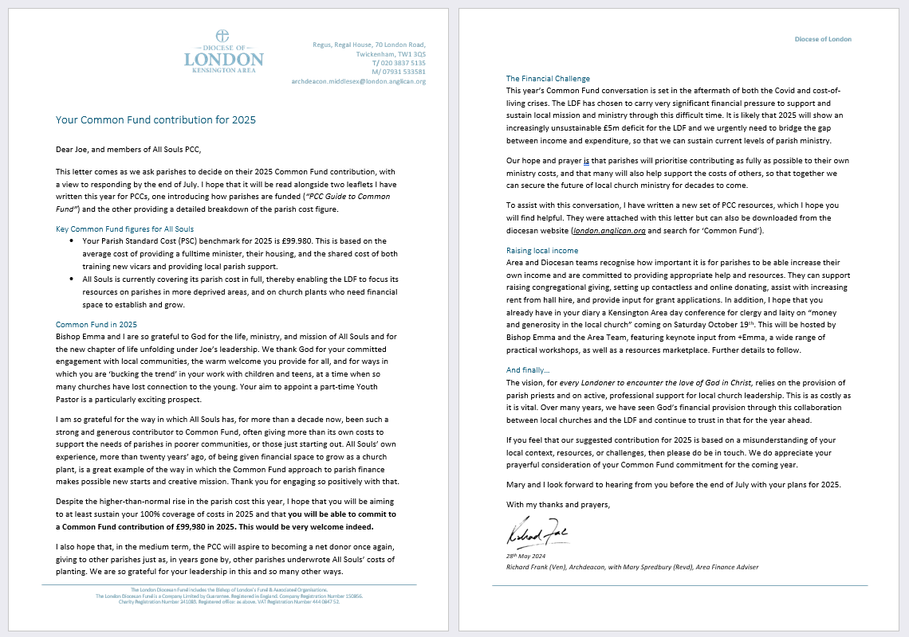
It starts with a suggestion…
Notes:
AD
Talk about letter – by end of May
If we’ve got it wrong, say…

Slide 21

Guide for PCCs
Notes:
AD
Alongside this letter, which is not just for the vicar/treasurer, but for every PCC member
We’ve got a completely rewritten and designed guide for PCCs – this is essential reading – you can find it already on the website

Slide 22
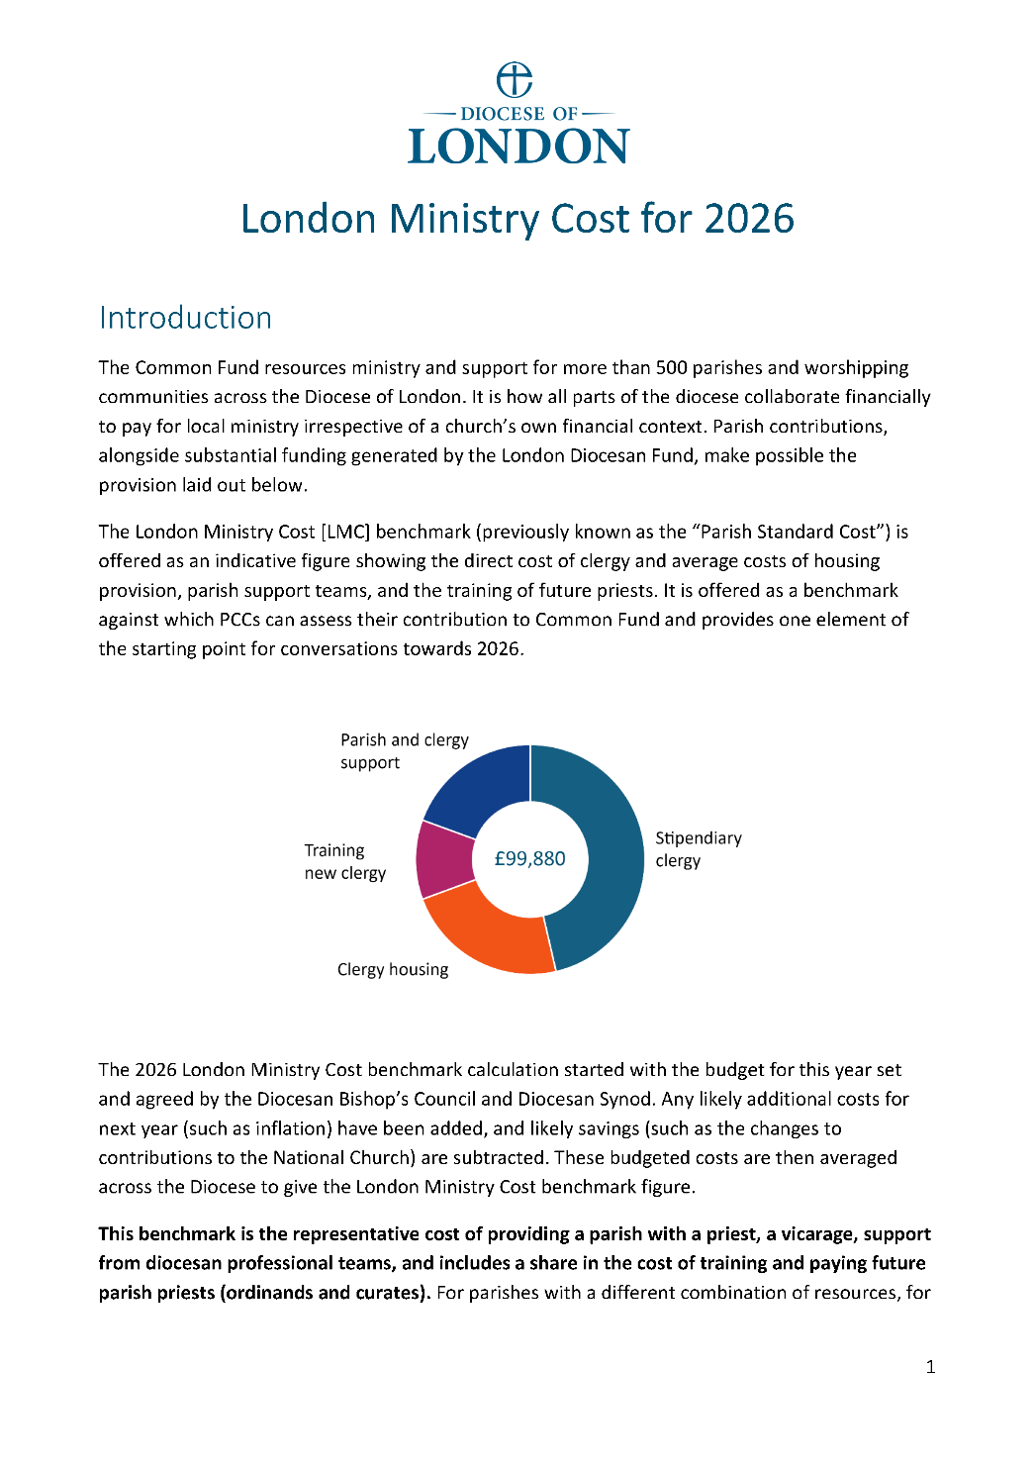
London Ministry Cost
benchmark
Notes:
Then, for those on your PCC who would like the detail of the origins of the cost figure, there’s a detailed guide

Slide 23
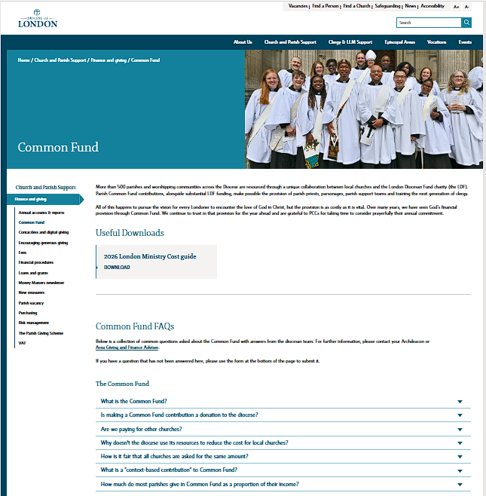
Downloads and FAQs
london.anglican.org/common-fund
Notes:
…and a web page devoted to the CF – with downloads (leaflets, this presentation, powerpoint etc) and FAQs

Slide 24

Questions
Notes:
[take questions]

Slide 25
Supporting parish finances
The Parish Giving Scheme
Contactless giving
Running a giving programme
National generosity resources
Increasing hall hire returns – https://www.sharesy.com/
Advice on financial management
Fundraising team
Legacy Giving
Loans and grants
Notes:
AGFA
This is a good moment to mention the ways in which we offer to support, resource, and advise parishes in increasing their income
- very brief (very brief) run through of each of the bullets and invitation to ask afterwards or by email

Slide 26
Notes:
AD
Summary and reminder of what CF is and is for…

Slide 27
Thank you!

