Slide 1
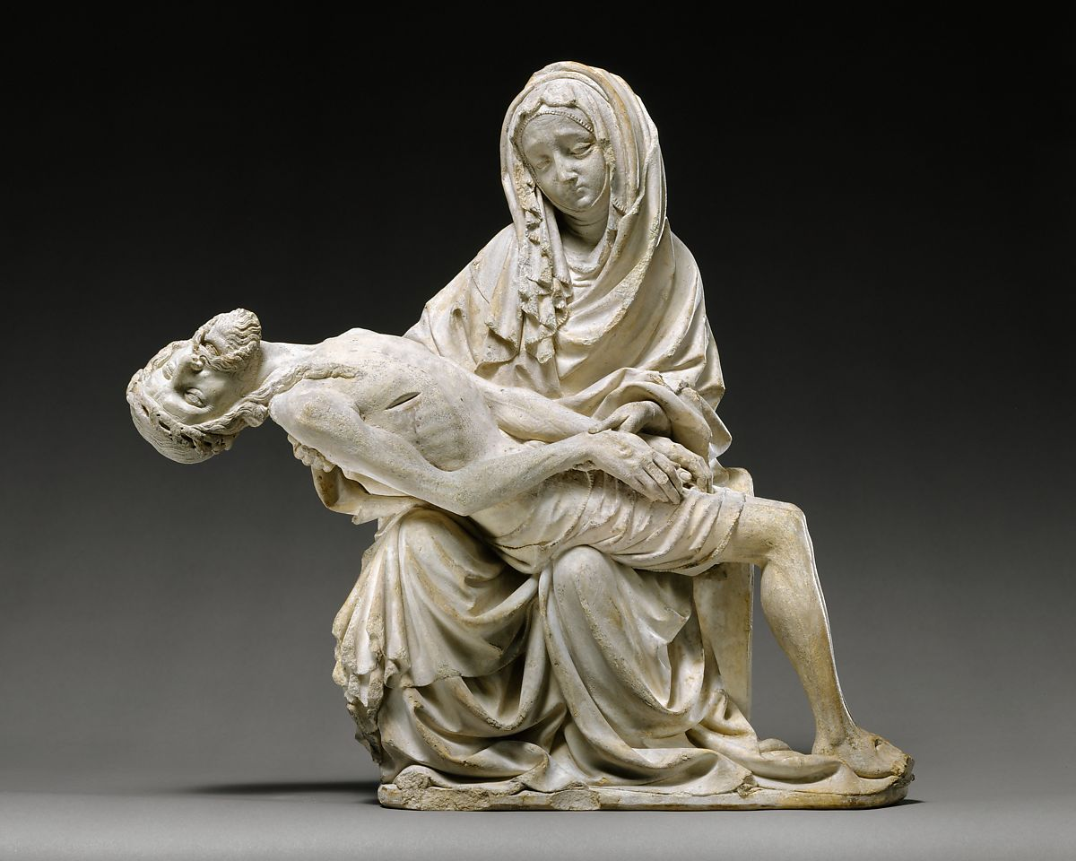
The Pieta Prayer Writing Resource
An inter-diocesan collaboration
For schools and churches in
London & Southwark Dioceses

Slide 2
Copyright Disclaimer
This teaching resource has been specifically created for use by teachers, educators and students for purely educational and non-commercial purposes. It a free resource that has been strictly and explicitly created to structure learning, provide visual stimulus and promote creative and pastorally relevant discussion and support for children and young people. No other use is permitted under any circumstances.
All works created through engagement with these teaching materials are intended to promote and enable the pastoral care and wellbeing of children and young people within their educational and/or faith settings. A small sample of the student created works will be included in a non-commercial, not for profit prayer resource. The published prayer resources that will be made after the conclusion of the competition will be used teaching and learning. Any funds raised will be used to cover the cost of realisation or to support pastoral or wellbeing for those who face contextual safeguarding risk and/ SYV.
No credit is taken for the artworks, images, photographs, videos blog links or other publicly available resources within this resource. All the artists and creators rights are acknowledged, respected and reserved. No infringement is intended, authorised or accepted by the issuing organisations. By choosing to download, open or use this resource, all users are strictly agree to use this resource within these parameters and for the expressed intentions.
If any user finds that they are unable to abide by, adhere to or are otherwise prevented from working within this framework of permissions, they are required to immediately delete all the resources from their equipment and desist from any further engagement.

Slide 3
Prayer
Prayer is a form of communication that can range from thoughts, simple words to pleas, questions and conversation. Spoken or unspoken they are directed to God. They may be personal and private or corporate and public. They can be extemporary or more liturgically structured.
Whether they are short poems or extended prefaces they form us to think, speak and reflect on God. They teach us to turn towards God, with the trusting expectation that God is present and will hear us. They create space for us to hear from God.
Prayer helps us to acknowledge, connect and grow in relationship with God. Prayer works to change our hearts. In this way, prayer changes our relationships and even our approach to our circumstances. Over time, within the will and purposes of God, prayer can and do change our world.

Slide 4
Pieta
Always the same hills Crowd the horizon, Remote witness Of the still scene. And in the foreground The tall Cross, Sombre, untenanted, Aches for the Body That is back in the cradle Of a maid's arms
R S Thomas
Notes:
Additional information https://livingwittily.typepad.com/my_weblog/2020/06/last-year-i-found-a-first-edition-of-piet%C3%A0-by-r-s-thomas-his-seventh-published-volume-twenty-eight-of-the-thirty-five-poe.html

Slide 5
Further teaching resources or research sources
Luke 2:34–35
³⁴and Simeon blessed them and said to Mary his mother,
“Behold, this child is set for the fall and rising of many in Israel,
and for a sign that is spoken against
³⁵(and a sword will pierce through your own soul also),
that thoughts out of many hearts may be revealed.”
Click on the VCS title to be the linked to the resources
Notes:
Ott, Martin. 2021. 'A Sword Will Pierce Your Own Heart Also', in The Visual Commentary Of Scripture ed. by Ben Quash. (London: The Visual Commentary on Scripture Foundation). [Accessed 5.12.2022] https://thevcs.org/sword-will-pierce-your-own-heart-also
Luke 2:34–35
Bible passage (Revised Standard Version)
³⁴and Simeon blessed them and said to Mary his mother,
“Behold, this child is set for the fall and rising of many in Israel,
and for a sign that is spoken against
³⁵(and a sword will pierce through your own soul also),
that thoughts out of many hearts may be revealed.”

Slide 6
Prayer Writing Frames
Thumb | Family – Those closest to us
Fore finger | Teachers - Those who teach us and guide us and point us in the right direction.
Middle finger | Leaders – Those with responsibility over others.
Ring Finger | Caretakers - People who commit to caring for us in our communities: Health & Medical/ Site Staff/ Lunchtime SMSA
Little finger | ‘Least of these’ – Often the smallest or most unseen, yet much loved by God

Slide 7
Prayer Writing Frames
Theme | Section | Intercessions Sentence starters | Purpose/ Intent/ SC
Opening up to God | Opening Address | Loving/ Merciful/Gracious God, We give you thanks for… We bring to you our needs and the needs of your world BECAUSE…. | Relational Opening/ Orientation setting Articulating the nature and personhood of God Giving thanks and voicing needs/challenges
 |  | Call: Lord in your mercy Response: Hear our prayer
The Church | Local community/ congregation |  | Giving thanks and voicing needs/challenges
 | Diocesan |  | For Senior Area & Diocesan Clergy Giving thanks and voicing needs/challenges
 | National |  | Giving thanks and voicing needs/challenges
 |  | Call: Lord in your mercy Response: Hear our prayer
The World | Environmental Economic Social Political Human International concerns: War/ Famine/ Pestilence
 |  | Call: Lord in your mercy Response: Hear our prayer
Healing of the Sick & Communion of Saints | Sick & Dying
 | Dead | We pray for those who h rave died recently… We pray for those whose Anniversary of death… | Recently deceased… Particularly those that who died last night and were alone, afraid, unprepared or died by violence… We pray for their families as they hear this news We pray for those whose Anniversary of death…
 |  | Recently deceased… Particularly those that who died last night and were alone, afraid, unprepared or died by violence… We pray for their families as they hear this news We pray for those whose Anniversary of death…

