Slide 1
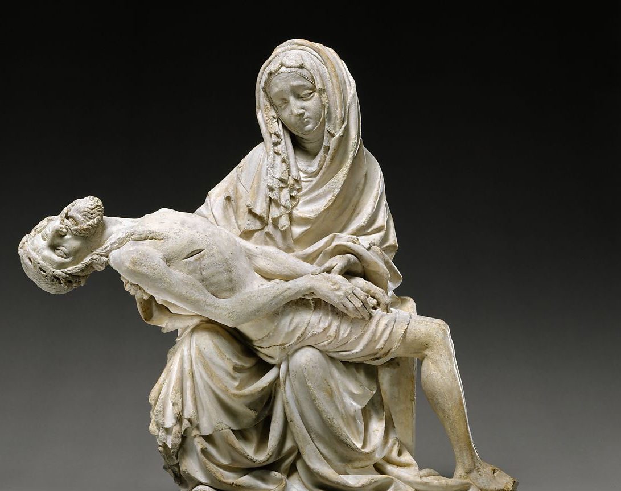
The Pieta Prayer Resource
An inter-diocesan collaboration for schools and churches in London & Southwark Dioceses
Notes:
https://www.metmuseum.org/art/collection/search/473331
Pietà (Vesperbild)ca. 1400
Bohemian

Slide 2
Copyright Disclaimer
This teaching resource has been specifically created for use by teachers, educators and students for purely educational and non-commercial purposes. It a free resource that has been strictly and explicitly created to structure learning, provide visual stimulus and promote creative and pastorally relevant discussion and support for children and young people. No other use is permitted under any circumstances.
All works created through engagement with these teaching materials are intended to promote and enable the pastoral care and wellbeing of children and young people with their educational and/or faith settings. A small sample of the student created works will be included in a non-commercial, not for profit prayer resource. The published prayer resources that will be made after the conclusion of the competition will be used teaching and learning. Any funds raised will be used to cover the cost of realisation or to support pastoral or wellbeing for those who face contextual safeguarding risk and/ SYV.
No credit is taken for the artworks, images, photographs, videos blog links or other publicly available resources within this resource. All the artists and creators rights are acknowledged, respected and reserved. No infringement is intended, authorised or accepted by the issuing organisations. By choosing to download, open or use this resource, all users are strictly agree to use this resource within these parameters and for the expressed intentions.
If any user finds that they are unable to abide by, adhere to or are otherwise prevented from working within this framework of permissions, they are required to immediately delete all the resources from their equipment and desist from any further engagement.

Slide 3
The German word for ‘Pieta’ is ‘Vesperbild’. This particular Vesperbild is dated to c.1400 and so predates Michelangelo's Pieta. The artist is unknown. It is regarded as ‘Bohemian’ which means it is from Central Europe.
In pairs, compare and contrast this Vesperbild with the Michelangelo's Pieta.
What do you notice? What is impact?
Notes:
This lesson/ phase of learning draws on a ‘models of excellence’ approach to help students become more:
a) Aware of their own internalised criteria and preferences.
b) Aware of other people’s criteria and preferences/ expectations
c) Aware of ‘selection criteria’ – to ensure that they full understand and appreciate the expectations.
https://www.metmuseum.org/art/collection/search/473331
Pietà (Vesperbild)ca. 1400
Bohemian

Slide 4
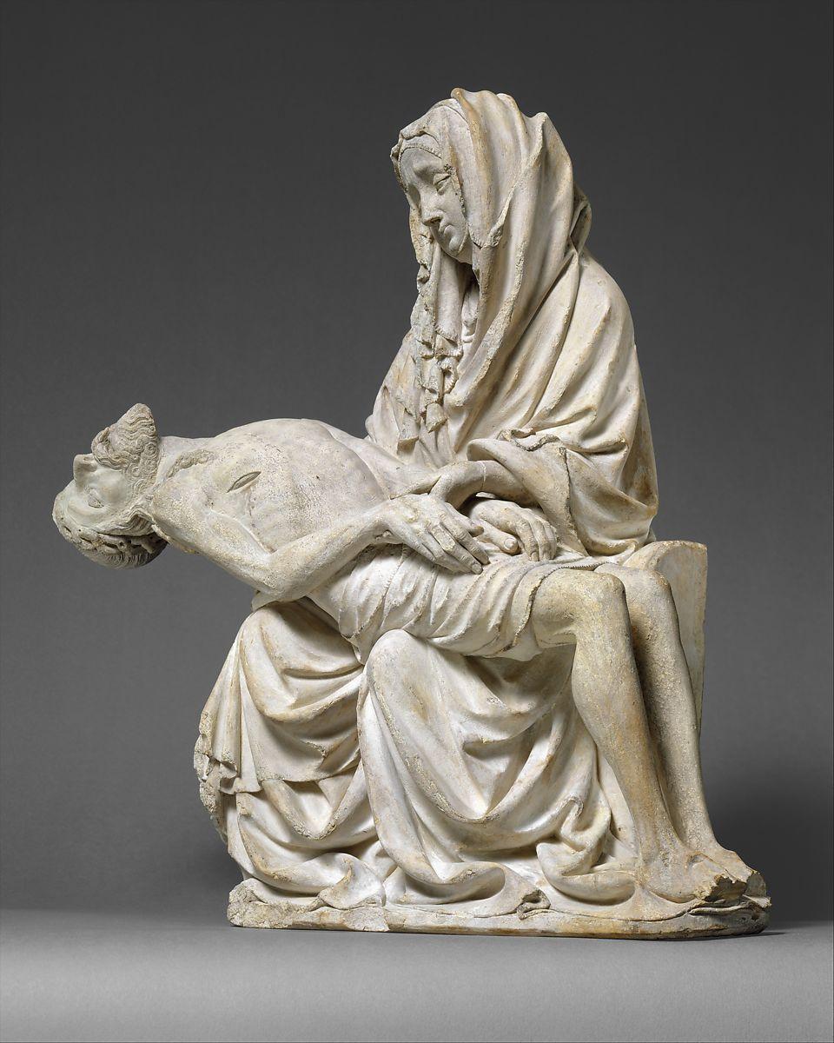
Pieta Resource Project Aims
To develop a new prayer resource for schools and churches in London & Southwark Dioceses.
To learn from, create and showcase contemporary religious art.
To prompt regular prayer.
To publish a range of postcards, bereavement notecards and larger canvas prints for display.

Slide 5
Why are we doing this?
REASONS…
Creative/Technical:
Pastoral:
Spiritual Disciplines & Development :
Existential:
Create an high quality prayer resource, that can be used in CE schools & churches so that communities are regularly praying about contextual safeguarding, community safety and SYV.
Create safe spaces and prayer opportunities for students and young people to pray about their concerns, anxieties, experiences, grief and trauma, whether at school or in church.
Develop confident prayer writing skills as well as using Christian imagery and imagination to help students and young people draw near to God through personal and collective prayer.
Ensure students and young people in schools and churches feel well-supported in relation to their experiences of ‘peer on peer’ aggression and abuse; contextual safeguarding and community violence. Their concerns are seen, heard and regularly prayed about.

Slide 6
Learning Objectives
Over the next few weeks
Today’s session:
Learn about aspects of Christian art history and spiritual imagination of the Pieta
Engage with a selection of Pieta re-interpretations in a range of medias.
Reflect on how to connect the viewer with the tragedy of a young man’s death and a mother’s grief.
Plan, organise resource and execute a pieta that can be reproduced as a high quality postcard, bereavement card or print.
Know about the spiritual purpose and prayerfulness of iconography, and consider ways to draw upon this tradition/ apply these practices when working upon a commission.
Pieta Lesson Phase 2
To engage with a wider range of modern and contemporary examples of the pieta and reflect on their social relevance, critique and impact
To develop a success criteria for an effective, ethical and inclusive pieta.
To be able to consider how the Pieta might be used to reflect the diverse range of young people affected by contextual risk and community violence

Slide 7
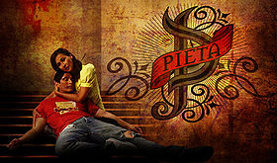
Filipino theatre artists perform a "La Pieta" scene during a short musical about the killings under the Philippine government's anti-drug campaign, in Pandacan city, metro Manila, Philippines April 2, 2017. REUTERS/Romeo Ranoco
Pieta is a Philippine television daytime drama series that aired from
October 27, 2008 to May 1, 2009,
It is important to be aware that although Christianity is an Afro-Asiatic religion because of European colonialism, Western Christian art forms have heavily influenced global Christian practices and imagination so have been inserted into a wide range of cultures.
This means that the Pieta is well-known outside of Europe.
Notes:
It is important to be aware that although Christianity is an Afro-Asiatic religion because of European colonialism, western Christian art forms have been inserted into a wide range of cultures.

Slide 8
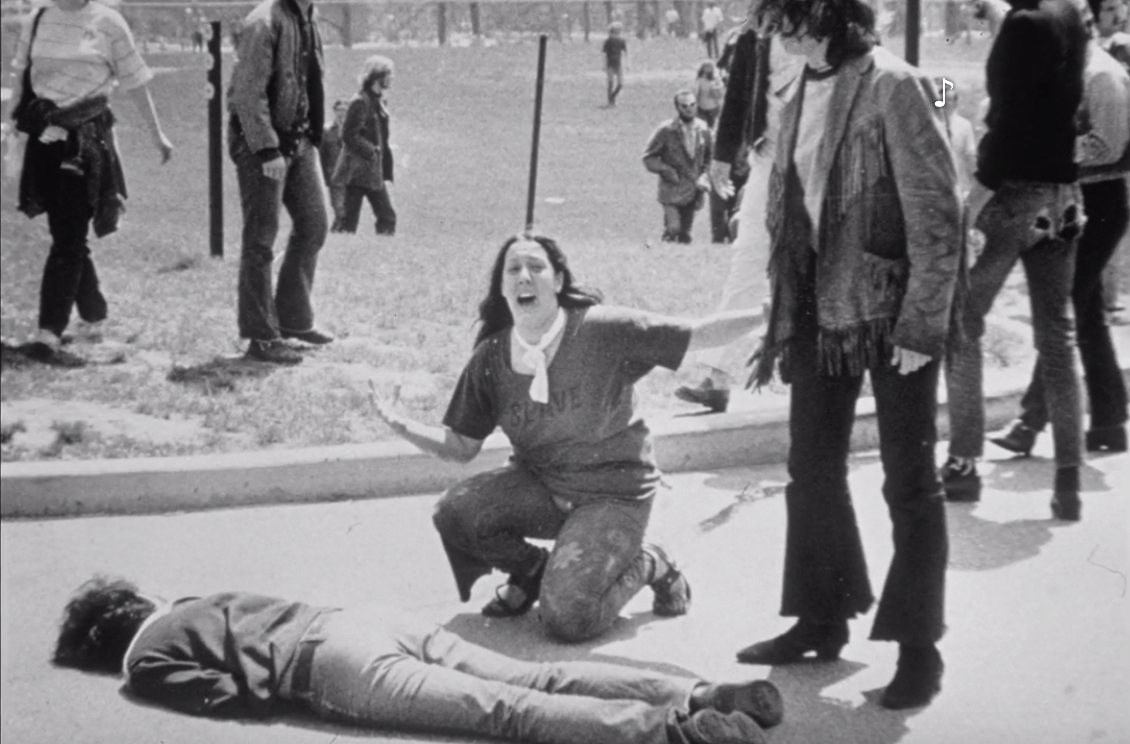
The Kent State Pietà
Notes:
https://www.washingtonpost.com/magazine/2021/04/19/girl-kent-state-photo-lifelong-burden-being-national-symbol/
Please note that person lying on the floor has been killed, so you are looking at an actual dead body.
If this was your relative how would you feel about this image being used/ shown on news publications or postcards.
Art and drama can do what real life cannot.
Is it news or political art?

Slide 9
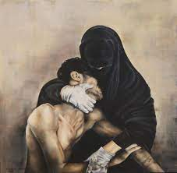
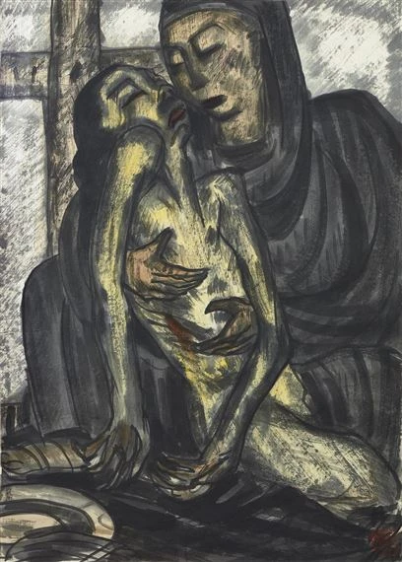
Pieta, 1930s by Lin Fengmian, Cernuschi Museum, Paris
Your pieta needs to draw attention to issues that are important to you: Unseen grief, oppression and tragedy.
However, it is important to root your pieta in relationship and context.
What is your connection to the issue that is being highlighted? Why do you care about this pieta?
Prayerfully consider how you or your family, friends, community and school have impacted by a lack of community safety, contextual safeguarding risks or incidents of serious youth violence.
This will help give your piece its authenticity.
Pietà yemenita 2012 by Maria Paola Ceccarini
Notes:
Your pieta needs to draw attention to issues that are important.
Unseen grief. Oppression and Tragedy.
However, it is important to root your pieta is relationship.
What is your connection to the issue that is being highlighted?
In what ways are you connected to the pieta and affected by serious youth violence?

Slide 10
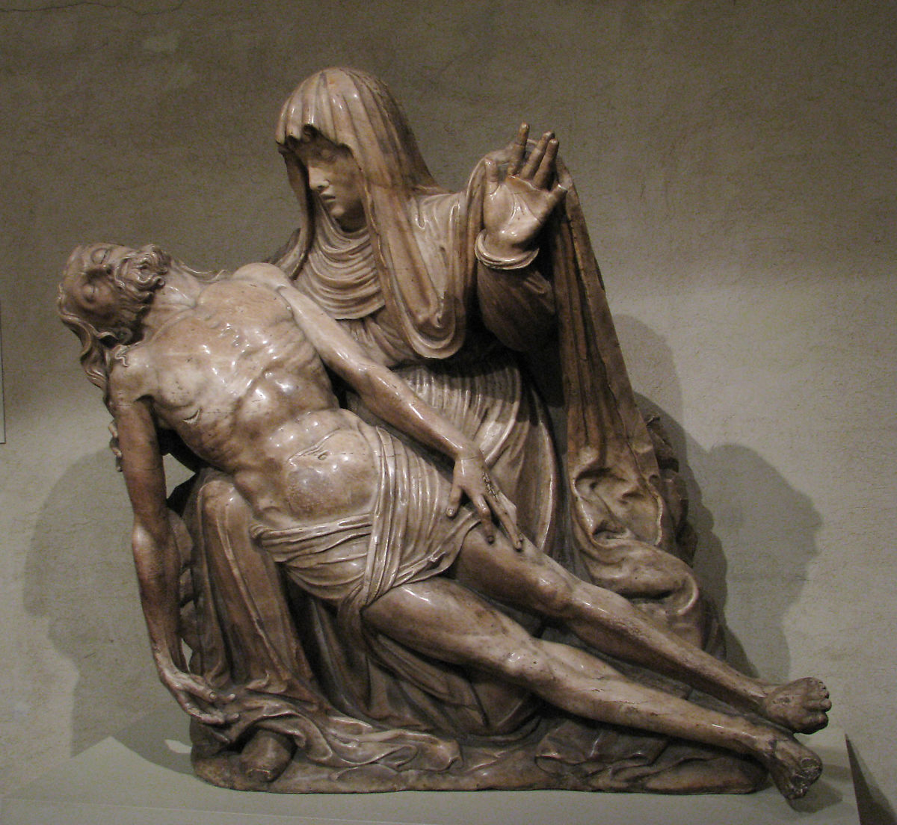
Think about how the posture of Christ’s body adds drama and movement as well as information about the context
A Spanish Pietà
Artist Unknown
Second quarter 16th century
Armenian Cathedral of Lviv, Ukraine
Tweeted 5th March 2022
Credit: Tim Le Berre

Slide 11
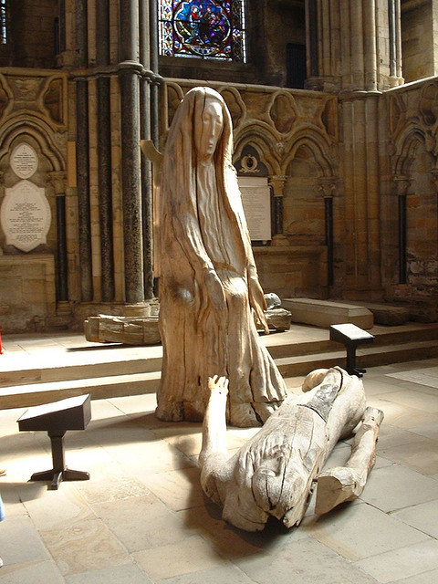
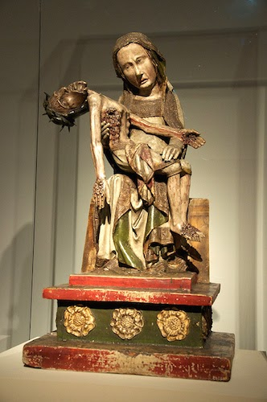
The Röttgen Pietà Rheinisches Landesmuseum, Bonn
Click on the images to listen to an analysis or read a reflection.
Pieta by Fenwick Lawson at
Durham Cathedral
Notes:
The Röttgen Pietà
Video: https://youtu.be/vsjl4aE2VkA
Additional information/ analysis: http://faithisntwhatyouthink.blogspot.com/2020/11/christian-theologians-and-artists-have.html

Slide 12
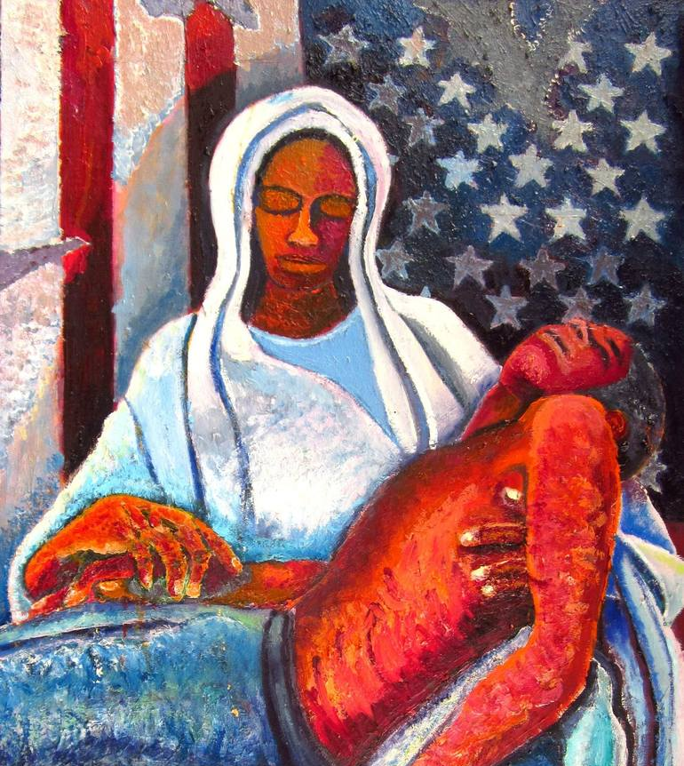
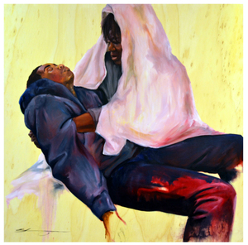
American Pieta by Michael Owens
Shanequa Gay ‘Pieta’
Oglethorpe University, Georgia
Click on the image to listen a video interview with Shanequa who explores the reasoning and underlying themes within her spiritually and religiously influenced art works.
Notes:
How do these artists communicate grief, empathy and softness?
Why might it have been important to the artists to communicate this, in these particular pietas?
What are they trying to help us see?
What social constructs are they addressing?

Slide 13
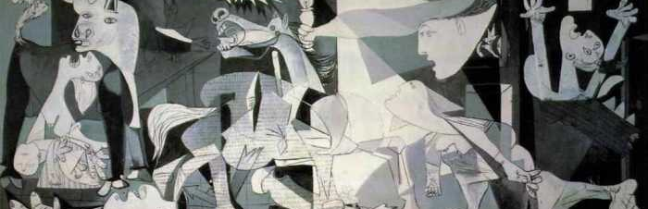
Sometimes an artist will incorporate the pieta sentiment within a broader narrative, but usually the attention of viewer is drawn to the central relationship between Mary and her son.
Can you find the pieta motif within this piece?
Can you guess who the artist might be?
What do you think they were trying to communicate?
Click on the image to find out more.
Notes:
Sometimes artist incorporate the pieta sentiment within a broader narrative, but usually the attention of viewer is drawn to the central relationship between Mary and her son.

Slide 14
Notes:
Compare and contract these different aspects of this stain glass pieta image: Mary, Comforter of the Afflicted (2016) by Kehinde Wiley
https:/wherecreativityworks.com/kehinde-wiley-blm/
https://en.wikipedia.org/wiki/Kehinde_Wiley
https://ashadedviewonfashion.com/2016/10/23/kehinde-wiley-lamentation-at-petit-palais-fiac-out-of-the-walls-by-marco-de-rivera/

Slide 15
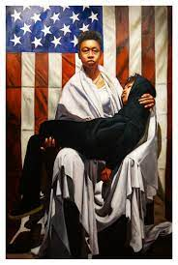
Notes:
Artist’s Black Pietà a Call for Justice - Grotto Doc. #162
:P https://www.youtube.com/watch?v=PfPZ-yJ77RQ
War Pietas
One pieta speaks about an external war.
The other comments on an internal war.
What is the role of patriotism in these pietas?
Is there a place for patriotism is religious art?

Slide 16
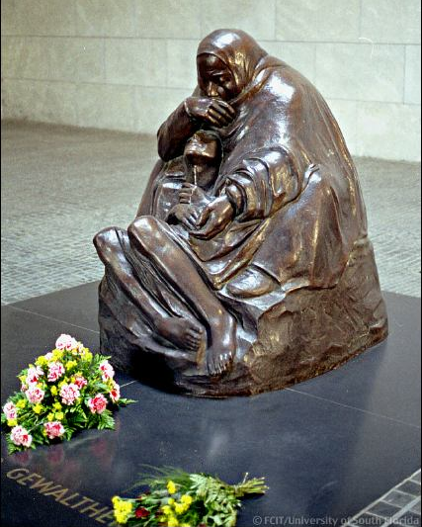
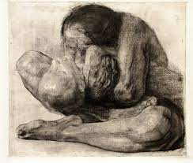
How does the artist, Kollwitz express Mary’s emotion through
Body language?
Facial expression?
Focus?
What does this communicate to the onlooker?
Notes:
Neue Wache in Berlin, Kollwitz
Here we revisit one of Kollwitz’s pieces but then contrast it with the same scene through a different medium.
Kollwitz’s own son was killed in WW1.
What do you think her personal experience of loss and grief brings to her work?

Slide 17
Further teaching resources and research sources
Luke 2:34–35
³⁴and Simeon blessed them and said to Mary his mother,
“Behold, this child is set for the fall and rising of many in Israel,
and for a sign that is spoken against
³⁵(and a sword will pierce through your own soul also),
that thoughts out of many hearts may be revealed.”
Click on the VCS title to be the linked to the resources
Notes:
Ott, Martin. 2021. 'A Sword Will Pierce Your Own Heart Also', in The Visual Commentary Of Scripture ed. by Ben Quash. (London: The Visual Commentary on Scripture Foundation). [Accessed 5.12.2022] https://thevcs.org/sword-will-pierce-your-own-heart-also
Luke 2:34–35
Bible passage (Revised Standard Version)
³⁴and Simeon blessed them and said to Mary his mother,
“Behold, this child is set for the fall and rising of many in Israel,
and for a sign that is spoken against
³⁵(and a sword will pierce through your own soul also),
that thoughts out of many hearts may be revealed.”

Slide 18
Pieta Criteria
Imagine yourself as a commissioned artist.
Task 1: Having explored a range of Pieta images, in different media, what do you think the key features of a Pieta should be? What will you include?
Task 2: Once you have written your criteria, discuss it with a peer. Are they similar or different? How and why do you think this has happened?
Task 3: Look at the ‘Pieta Selection Criteria’: Do you understand it? How is it similar to your own? How does it differ and what impact does this have? How does it help you to plan, draft and execute your own Pieta?

Slide 19
The London & Southwark Dioceses’ Pieta Prayer Competition
The Brief:
The Selection Criteria:
These works of art will be used to reflect upon grief, as a source of prayer, and to comfort the bereaved. They can be in any medium and any size, bearing in mind that the final form in which the image will be shared will be as a postcard, bereavement card, and larger-scale print.
The works of art will be closely connected with liturgy and worship. As prints, cards, and postcards, the art will provide opportunities for people to connect deeply with the Christian reality of Christ’s death and his mother’s suffering, as well as the urgent need for justice and an end to violence in our communities.
Entries will be judged based on the work of art’s engagement with:
Contemporary life.
Local community and school context.
The drama and grief of Christ’s death and Mary’s pain.
Spirituality and prayer.
‘Pity’ and ‘compassion’ as concepts and experiences.
The unique qualities and characteristics of the medium (photography, paint, etc)
Suitability for the final format (postcard and print).

Slide 20
The London & Southwark Dioceses’ Pieta Prayer Competition/ Commission
The school-based competition:
The inter-diocesan competition:
Will run from 5th January – 26th April 2023.
Must include a school-based exhibition of all the entries. This exhibition should be at least 3 days long (from 26th -28th April 2023) to allow the wider school community to appreciate the pietas.
Will require that high resolution photos of ALL the pietas MUST be taken on Wednesday 26th April 2023.
The school leaders and community must select TWO submissions that will be entered to represent the school must be uploaded to the Compassionate Communities website by 2pm on Friday 28th April 2023
Schools/ Academies will be asked to display all the entries on their website as an ongoing record and celebration of student efforts.
Resources for students and staff to write their own prayers will be provided and there will be an opportunity for prayers to be uploaded to a website create a bank of free intercession resources.
Will only accept TWO submissions from each individually named school/academy. These entries will form the competition long list.
The long list will be remotely viewed by an inter-diocesan, ecumenical and panel of judges between 2nd- 9th May, and reduced to a short list of up to 20 entries. Irrespective of the total number of entries received, this short list will be made up of no more than TEN entries from each respective diocese.
The panel of judges will physically meet in May 2023 to select the SIX finalists from each diocese.
From within the finalists group, ONE overall winner will be selected to represent each diocese.
The finalists and winning entries will be announced on the LDBS and SDBE websites as well as on the Compassionate Communities website.

Slide 21
The London & Southwark Dioceses’ Pieta Competition/ Commission
What will happen next?:
What will happen later in the year:
All twelve finalist images will be used to develop a high quality prayer resource that will be available for use in schools and churches. This resource will include A4 copies of the finalist pietas with liturgy and intercessions that can be used regularly and in times of need. This resource will be priced to recover design and reproduction costs.
All twelve finalists will be invited to celebration event(s) to recognise their work and skills.
By submitting entries to the long list all schools, students and parent/carer/adults agree to the free use, display and reproduction of the images within London & Southwark dioceses for the purposes of promoting community safety and contextual safeguarding, and interrupting serious youth violence.
Any proceeds raised will be strictly used to cover the reproduction costs for resources or ring-fenced to support church based interventions that specifically promote community safety, contextual safeguarding and wellbeing for young people who are at risk.
The five runner up finalists from London diocese and the five runner up finalists from Southwark diocese will be published as a collection of ten postcards which will be available for purchase through Church House and other appropriate outlets.
The winning entry for London diocese and the winning entry for Southwark diocese will each be published as individual bereavement cards that can be purchased through Church House and other appropriate outlets.
The two winning entries will be used by their respective dioceses to help focus prayer, signpost and connect resources and help brand the diocesan work done to promote community safety and interrupt serious youth violence.

