Slide 1
The Pieta Prayer Resource
An inter-diocesan collaboration for schools and churches in London & Southwark Dioceses

Slide 2
Copyright Disclaimer
This teaching resource has been specifically created for use by teachers, educators and students for purely educational and non-commercial purposes. It a free resource that has been strictly and explicitly created to structure learning, provide visual stimulus and promote creative and pastorally relevant discussion and support for children and young people. No other use is permitted under any circumstances.
All works created through engagement with these teaching materials are intended to promote and enable the pastoral care and wellbeing of children and young people with their educational and/or faith settings. A small sample of the student created works will be included in a non-commercial, not for profit prayer resource. The published prayer resources that will be made after the conclusion of the competition will be used teaching and learning. Any funds raised will be used to cover the cost of realisation or to support pastoral or wellbeing for those who face contextual safeguarding risk and/ SYV.
No credit is taken for the artworks, images, photographs, videos blog links or other publicly available resources within this resource. All the artists and creators rights are acknowledged, respected and reserved. No infringement is intended, authorised or accepted by the issuing organisations. By choosing to download, open or use this resource, all users are strictly agree to use this resource within these parameters and for the expressed intentions.
If any user finds that they are unable to abide by, adhere to or are otherwise prevented from working within this framework of permissions, they are required to immediately delete all the resources from their equipment and desist from any further engagement.

Slide 3
Learning Objectives
Over the next few weeks
Today’s session:
Learn about aspects of Christian art history and spiritual imagination of the Pieta
Engage with a selection of Pieta re-interpretations in a range of medias.
Reflect on how to connect the viewer with the tragedy of a young man’s death and a mother’s grief.
Plan, organise resource and execute a pieta that can be reproduced as a high quality postcard, bereavement card or print.
Learn about the spiritual purpose and prayerfulness of iconography, and consider ways to draw upon this tradition/ apply these practices when working upon a commission.
Pieta Lesson Phase 1
To know about the history, artistic significance and spiritual imagination of the Pieta.
To consider traditional and contemporary examples of the pieta and identify key features.
To reflect on how the Pieta might help people to think, pray and act to address the underlying causes of Serious Youth Violence (SYV) within London communities.

Slide 4
Why are we doing this?
REASONS…
Creative/Technical:
Pastoral:
Spiritual Disciplines & Development :
Existential:
Create an high quality prayer resource, that can be used in CE schools & churches so that communities are regularly praying about contextual safeguarding, community safety and SYV.
Create safe spaces and prayer opportunities for students and young people to pray about their concerns, anxieties, experiences, grief and trauma, whether at school or in church.
Develop confident prayer writing skills as well as using Christian imagery and imagination to help students and young people draw near to God through personal and collective prayer.
Ensure students and young people in schools and churches feel well-supported in relation to their experiences of ‘peer on peer’ aggression and abuse; contextual safeguarding and community violence. Their concerns are seen, heard and regularly prayed about.

Slide 5
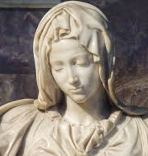
What do you notice?
Age
Gender
Culture & Ethnicity
What clues are there that this Pieta was made within the Western Christian tradition?
Talk with a partner about:
Reflection, Symmetry & Shape?
Suffering or Serenity?
Peace, Piety or Pity?
Use of Time & Space?
Connection?
What do you notice about Mary and Jesus’ faces?
Notes:
What do you notice?
Age
Gender
Race & Ethnicity: What clues are there that this piece of art was made is the Western Christian tradition?
Suffering or Serenity
Time:
Reflection, Symmetry, Shape & Form

Slide 6
Click on the image above to watch a short video analysis.
What do you notice about Mary and Jesus’ faces?
Notes:
What do you notice?
Age
Gender
Race & Ethnicity: What clues are there that this piece of art was made is the Western Christian tradition?
Suffering or Serenity
Time:
Reflection
Short video https://youtu.be/JdXmygDQCNc Spencer’s Painting of the Week: Michelangelo's Pieta –An Analysis (hyperlinked to the largest photo of Mary’s face)
Alternative; https://youtu.be/9YlLf8OmQag - History of Art :Pieta by Michelangelo
Longer video https://youtu.be/so6pw5beJOg - Art History Girl: Michelangelo's Pieta meaning and analysis (the sculpture that made him famous) | St Peter's, Rome

Slide 7
There are many examples of Pieta images in all kinds of different styles, histories, media, and contexts.
The most famous Pieta is Michelangelo’s marble sculpture in Rome. However, a Pieta image can be in any medium, from paint and textiles to photography and stained glass.
Here are some examples:

Slide 8
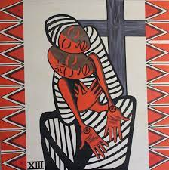
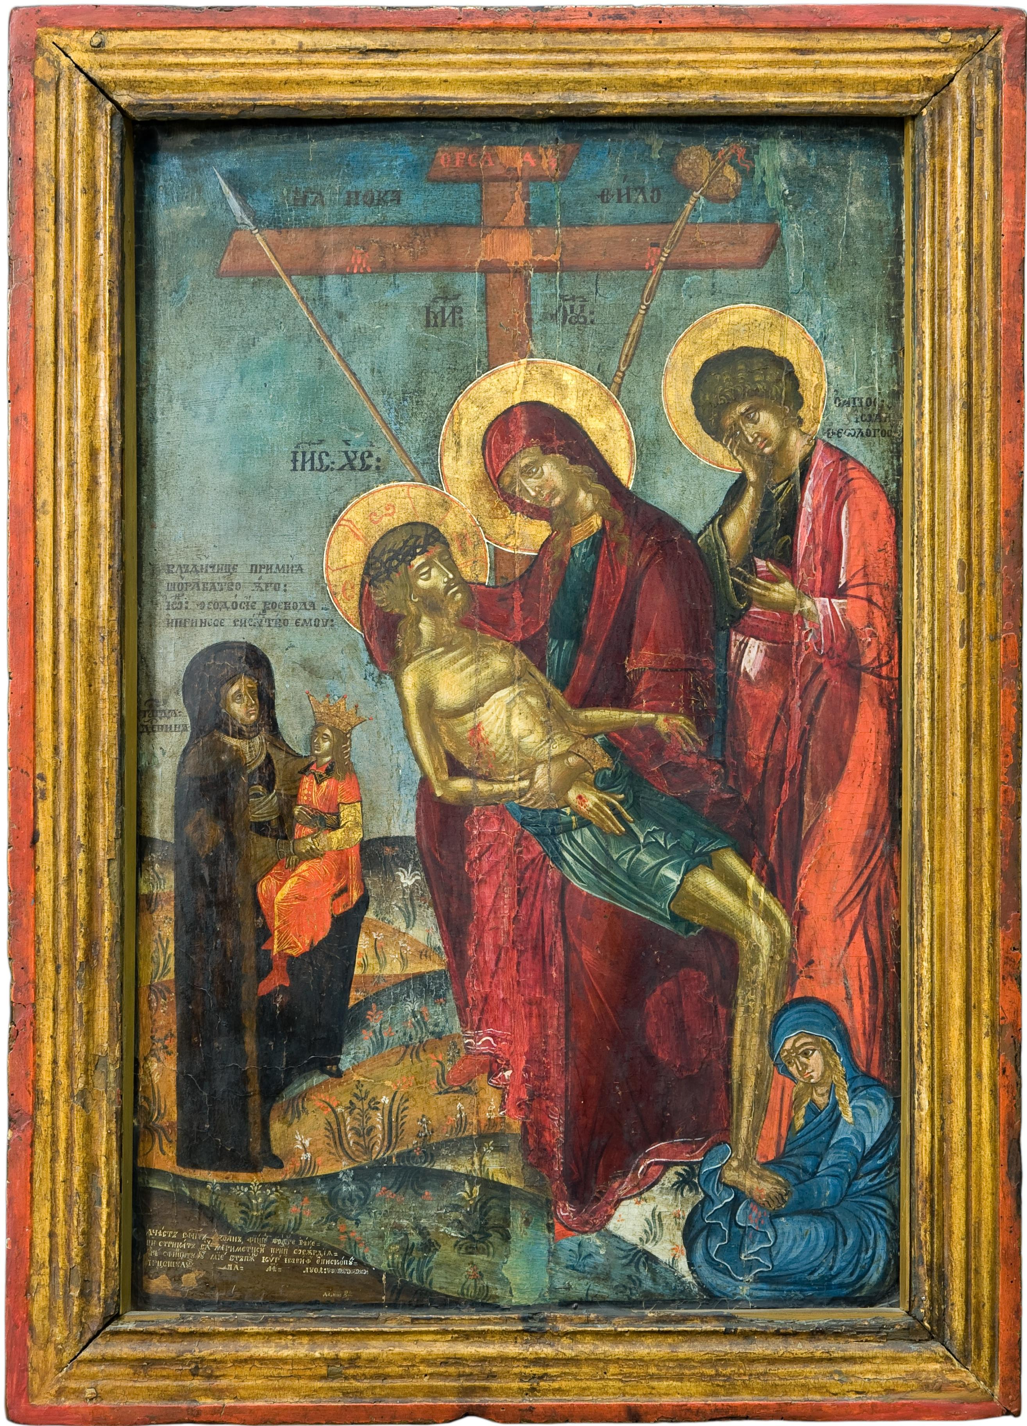
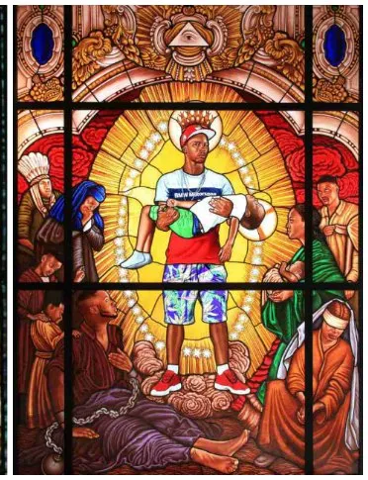
Click on an image to find out more about the pieta…
Notes:
https://en.wikipedia.org/wiki/Kehinde_Wiley
Developing Critical Awareness
Ask students to be mindful that they are reading these analysis through the eyes/lens and biases of the art critic who writes them.
One of the offered analysis is titled ‘An African Pieta’.
What perceptions might this ‘title’ create or reveal given that there are 54 nations within the continent of Africa?
How might the art writer’s analysis be retitled to avoid creating reductive misconceptions?

Slide 9
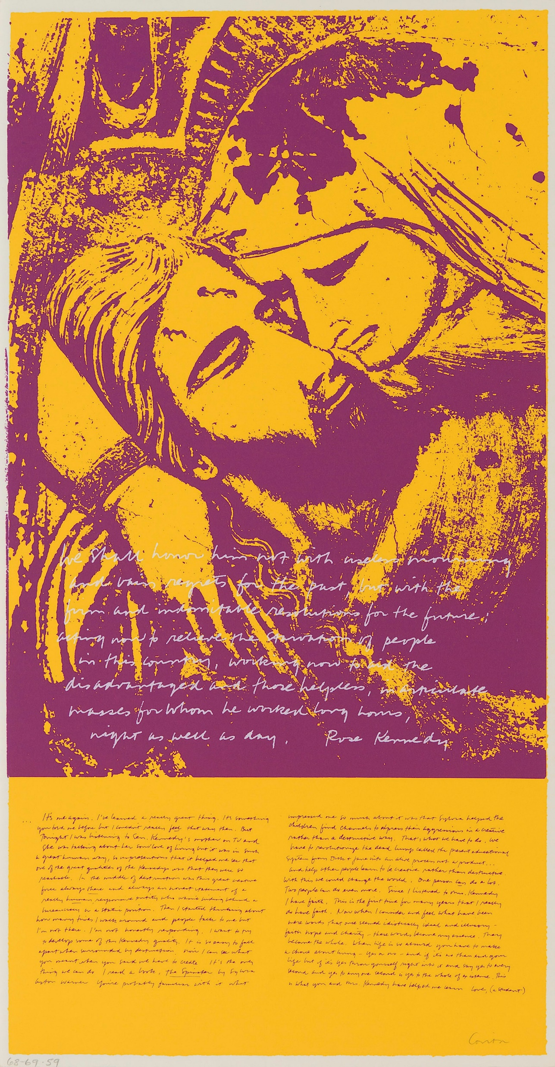
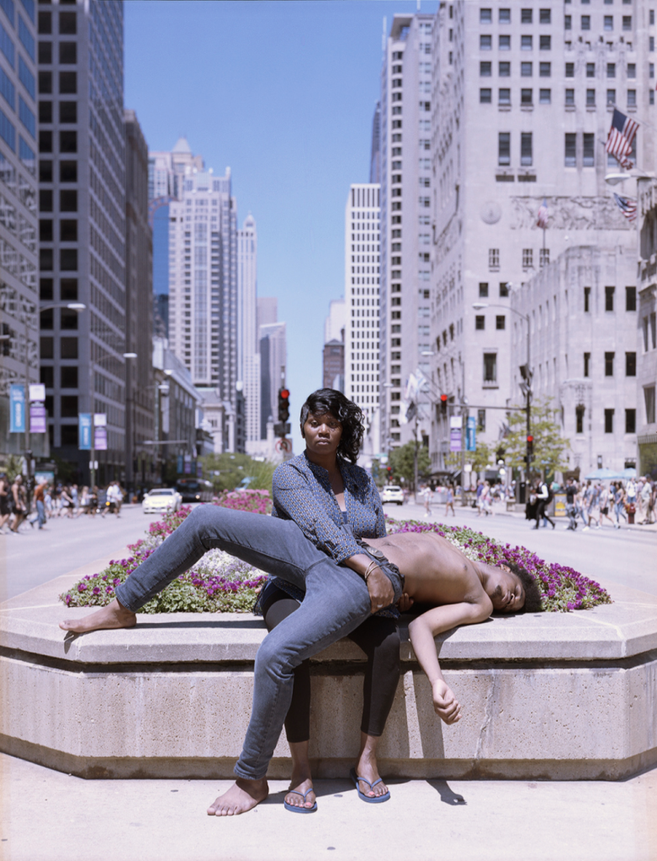
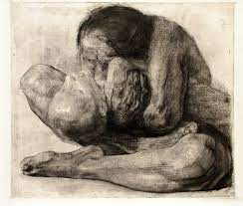
Click on an image to find out more about these pietas
How might you name your pieta to make it stand out to the viewer or judge?
Notes:
Additional information sources -
Käthe Kollwitz Woman with Dead Child
https://www.artsy.net/artwork/kathe-kollwitz-frau-mit-totem-kind-woman-with-dead-child
Jon Henry:
https://pdnonline.com/features/photographer-interviews/jon-henry-reimagines-the-pieta-in-photographs-of-black-mothers-and-sons/
Corita Pieta
https://collection.corita.org/piece/69-59
https://hammer.ucla.edu/collections/grunwald-center-collection/corita-kent/art/pieta-1969

Slide 10
The Pieta has been part of the Christian spiritual imagination for many centuries. Although not actually described in the gospel accounts, because Mary was present at her son Jesus’ death, it has been an image that has helped Christians contemplate the death of Christ, as observed through his mother’s grief.
Consequently, the Pieta has a unique capacity for imaginative re-interpretation which means that it has been revisited by artists to help focus attention and prayer on a range of contemporary issues and modern tragedies.
This year, students attending Church of England schools and academies in London and Southwark dioceses have the opportunity to enter a Pieta art competition that seeks to showcase the gifts and talents of the students and young people within Church of England settings, whilst drawing attention to the national issue of Serious Youth Violence.
All the pietas must first be exhibited within their own educational setting to instigate reflection and prayer. The leadership and community will need to select TWO submissions, that best meet the pieta selection criteria.
These Pietas will represent the school/ academy in the inter-diocesan competition.

Slide 11
The London & Southwark Dioceses’ Pieta Prayer Competition
The Brief:
The Selection Criteria:
These works of art will be used to reflect upon grief, as a source of prayer, and to comfort the bereaved. They can be in any medium and any size, bearing in mind that the final form in which the image will be shared will be as a postcard, bereavement card, and larger-scale print.
The works of art will be closely connected with liturgy and worship. As prints, cards, and postcards, the art will provide opportunities for people to connect deeply with the Christian reality of Christ’s death and his mother’s suffering, as well as the urgent need for justice and an end to violence in our communities.
Entries will be judged based on the work of art’s engagement with:
Contemporary life.
Local community and school context.
The drama and grief of Christ’s death and Mary’s pain.
Spirituality and prayer.
‘Pity’ and ‘compassion’ as concepts and experiences.
The unique qualities and characteristics of the medium (photography, paint, etc)
Suitability for the final format (postcard and print).

Slide 12
The London & Southwark Dioceses’ Pieta Prayer Competition/ Commission
The school-based competition:
The inter-diocesan competition:
Will run from 5th January – 26th April 2023.
Must include a school-based exhibition of all the entries. This exhibition should be at least 3 days long (from 26th -28th April 2023) to allow the wider school community to appreciate the pietas.
Will require that high resolution photos of ALL the pietas MUST be taken on Wednesday 26th April 2023.
The school leaders and community must select TWO submissions that will be entered to represent the school must be uploaded to the Compassionate Communities website by 2pm on Friday 28th April 2023
Schools/ Academies will be asked to display all the entries on their website as an ongoing record and celebration of student efforts.
Resources for students and staff to write their own prayers will be provided and there will be an opportunity for prayers to be uploaded to a website create a bank of free intercession resources.
Will only accept TWO submissions from each individually named school/academy. These entries will form the competition long list.
The long list will be remotely viewed by an inter-diocesan, ecumenical and panel of judges between 2nd- 9th May, and reduced to a short list of up to 20 entries. Irrespective of the total number of entries received, this short list will be made up of no more than TEN entries from each respective diocese.
The panel of judges will physically meet in May 2023 to select the SIX finalists from each diocese.
From within the finalists group, ONE overall winner will be selected to represent each diocese.
The finalists and winning entries will be announced on the LDBS and SDBE websites as well as on the Compassionate Communities website.

Slide 13
The London & Southwark Dioceses’ Pieta Competition/ Commission
What will happen next?:
What will happen later in the year:
All twelve finalist images will be used to develop a high quality prayer resource that will be available for use in schools and churches. This resource will include A4 copies of the finalist pietas with liturgy and intercessions that can be used regularly and in times of need. This resource will be priced to recover design and reproduction costs.
All twelve finalists will be invited to celebration event(s) to recognise their work and skills.
By submitting entries to the long list all schools, students and parent/carer/adults agree to the free use, display and reproduction of the images within London & Southwark dioceses for the purposes of promoting community safety and contextual safeguarding, and interrupting serious youth violence.
Any proceeds raised will be strictly used to cover the reproduction costs for resources or ring-fenced to support church based interventions that specifically promote community safety, contextual safeguarding and wellbeing for young people who are at risk.
The five runner up finalists from London diocese and the five runner up finalists from Southwark diocese will be published as a collection of ten postcards which will be available for purchase through Church House and other appropriate outlets.
The winning entry for London diocese and the winning entry for Southwark diocese will each be published as individual bereavement cards that can be purchased through Church House and other appropriate outlets.
The two winning entries will be used by their respective dioceses to help focus prayer, signpost and connect resources and help brand the diocesan work done to promote community safety and interrupt serious youth violence.

