Slide 1
The Pieta Prayer Resource
An inter-diocesan collaboration for schools and churches in London & Southwark Dioceses

Slide 2
Copyright Disclaimer
This teaching resource has been specifically created for use by teachers, educators and students for purely educational and non-commercial purposes. It a free resource that has been strictly and explicitly created to structure learning, provide visual stimulus and promote creative and pastorally relevant discussion and support for children and young people. No other use is permitted under any circumstances.
All works created through engagement with these teaching materials are intended to promote and enable the pastoral care and wellbeing of children and young people with their educational and/or faith settings. A small sample of the student created works will be included in a non-commercial, not for profit prayer resource. The published prayer resources that will be made after the conclusion of the competition will be used teaching and learning. Any funds raised will be used to cover the cost of realisation or to support pastoral or wellbeing for those who face contextual safeguarding risk and/ SYV.
No credit is taken for the artworks, images, photographs, videos blog links or other publicly available resources within this resource. All the artists and creators rights are acknowledged, respected and reserved. No infringement is intended, authorised or accepted by the issuing organisations. By choosing to download, open or use this resource, all users are strictly agree to use this resource within these parameters and for the expressed intentions.
If any user finds that they are unable to abide by, adhere to or are otherwise prevented from working within this framework of permissions, they are required to immediately delete all the resources from their equipment and desist from any further engagement.

Slide 3
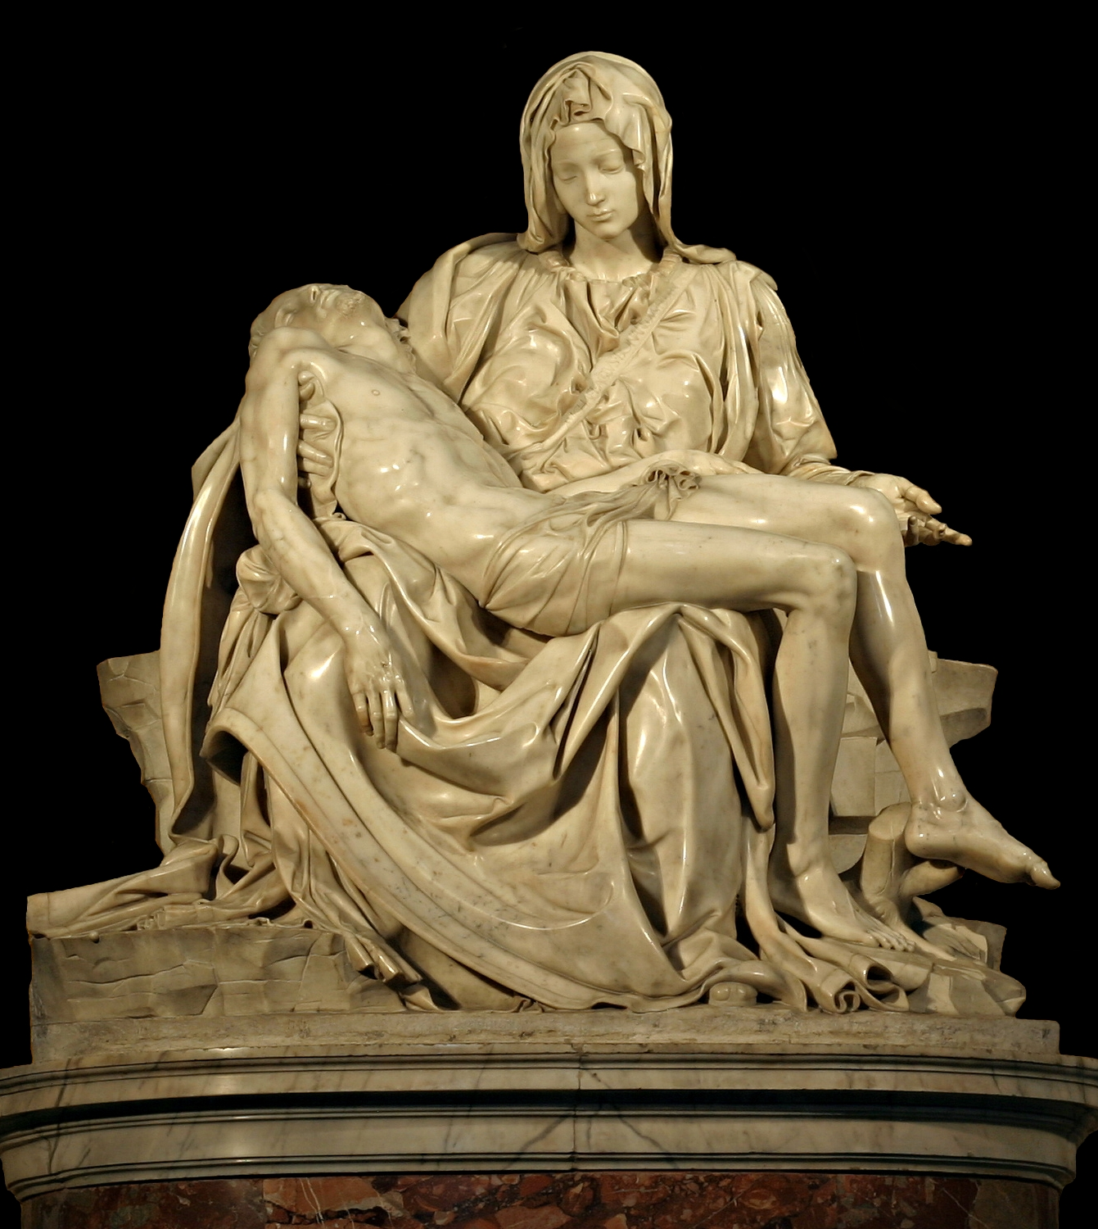
What do you know about this artwork?
What event is it capturing?
Who or what is it depicting?
What clues or evidence have informed your assertion?
What thoughts, feelings or connections does this sculpture bring to your mind?
What impact -if any – does the scene have on you?
This sculpture is Michelangelo’s first commissioned artwork. It was completed in 1498-99. It is called…
Notes:
Clues that this is Jesus & BVM: Nail marks, knife wound

Slide 4
‘The Pieta’
is a traditional Christian art form, which depicts the Virgin Mary grieving dead son, Jesus and holding him tenderly after the crucifixion. It has been an important part of Christian visual culture for over 600 years. This scene is not described in the Bible, but its imaginative power has encouraged Christians to reflect on the death of Christ, the uniquely deep grief of the Mother of God, and the desolation of Good Friday. Though sometimes images of the Mother of God mourning her Son show them alongside other people, Pieta images usually depict Mary and Jesus alone.
‘Pieta’ is a Latin word which can be translated as pity or compassion. It is also close to the English word ‘piety’, which is an expression of faithfulness in devotion and discipleship.
Notes:
Context by Dr Ayla Lepine.

Slide 5
The Pieta has been part of the Christian spiritual imagination for many centuries. Although not actually described in the gospel accounts, because Mary was present at her son Jesus’ death, it has been an image that has helped Christians contemplate the death of Christ, as observed through his mother’s grief.
Consequently, the Pieta has a unique capacity for imaginative re-interpretation which means that it has been revisited by artists to help focus attention and prayer on a range of contemporary issues and modern tragedies.
This year, students attending Church of England schools and academies in London and Southwark dioceses have the opportunity to enter a Pieta art competition that seeks to showcase the gifts and talents of the students and young people within Church of England settings, whilst drawing attention to the national issue of Serious Youth Violence.
All the pietas must first be exhibited within their own educational setting to instigate reflection and prayer. The leadership and community will need to select TWO submissions, that best meet the pieta selection criteria.
These Pietas will represent the school/ academy in the inter-diocesan competition.

Slide 6
The London & Southwark Dioceses’ Pieta Prayer Competition/ Commission
The school-based competition:
The inter-diocesan competition:
Will run from 5th January – 26th April 2023.
Must include a school-based exhibition of all the entries. This exhibition should be at least 3 days long (from 26th -28th April 2023) to allow the wider school community to appreciate the pietas.
Will require that high resolution photos of ALL the pietas MUST be taken on Wednesday 26th April 2023.
The school leaders and community must select TWO submissions that will be entered to represent the school must be uploaded to the Compassionate Communities website by 2pm on Friday 28th April 2023
Schools/ Academies will be asked to display all the entries on their website as an ongoing record and celebration of student efforts.
Resources for students and staff to write their own prayers will be provided and there will be an opportunity for prayers to be uploaded to a website create a bank of free intercession resources.
Will only accept TWO submissions from each individually named school/academy. These entries will form the competition long list.
The long list will be remotely viewed by an inter-diocesan, ecumenical and panel of judges between 2nd- 9th May, and reduced to a short list of up to 20 entries. Irrespective of the total number of entries received, this short list will be made up of no more than TEN entries from each respective diocese.
The panel of judges will physically meet in May 2023 to select the SIX finalists from each diocese.
From within the finalists group, ONE overall winner will be selected to represent each diocese.
The finalists and winning entries will be announced on the LDBS and SDBE websites as well as on the Compassionate Communities website.

Slide 7
The London & Southwark Dioceses’ Pieta Competition/ Commission
What will happen next?:
What will happen later in the year:
All twelve finalist images will be used to develop a high quality prayer resource that will be available for use in schools and churches. This resource will include A4 copies of the finalist pietas with liturgy and intercessions that can be used regularly and in times of need. This resource will be priced to recover design and reproduction costs.
All twelve finalists will be invited to celebration event(s) to recognise their work and skills.
By submitting entries to the long list all schools, students and parent/carer/adults agree to the free use, display and reproduction of the images within London & Southwark dioceses for the purposes of promoting community safety and contextual safeguarding, and interrupting serious youth violence.
Any proceeds raised will be strictly used to cover the reproduction costs for resources or ring-fenced to support church based interventions that specifically promote community safety, contextual safeguarding and wellbeing for young people who are at risk.
The five runner up finalists from London diocese and the five runner up finalists from Southwark diocese will be published as a collection of ten postcards which will be available for purchase through Church House and other appropriate outlets.
The winning entry for London diocese and the winning entry for Southwark diocese will each be published as individual bereavement cards that can be purchased through Church House and other appropriate outlets.
The two winning entries will be used by their respective dioceses to help focus prayer, signpost and connect resources and help brand the diocesan work done to promote community safety and interrupt serious youth violence.

